Slide 1
BCS1520: Statistics
Lecture 8:
Hypothesis Testing

Slide 2
Recap
Discrete and Continuous Random Variables.
Every random variable can be said to come from a distribution.
Common discrete distributions we went through: Bernoulli, Binomial, Poisson.
Common continuous distributions we went over: Normal and t-Distribution.

Slide 3
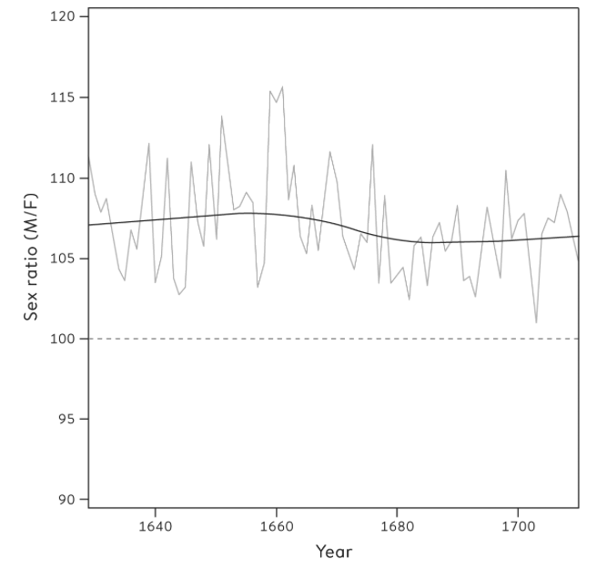
Are more boys born than girls?
John Arbuthnot looked at birth rates of boys and girls over 82 years from 1629 to 1710.
Calculated the sex ratio: Number of boys to 100 girls.
If the number of boys and girls born every year is the same, that is, there’s a 50/50 chance of either, then the sex ratio should be 1.

Slide 4
Are more boys born than girls?
If the number of boys and girls born every year is the same, that is, there’s a 50/50 chance of either, then the sex ratio should be 1.
Extrapolating that we would think then there should be 50/50 chance that the ratio is above or below 1.

Slide 5
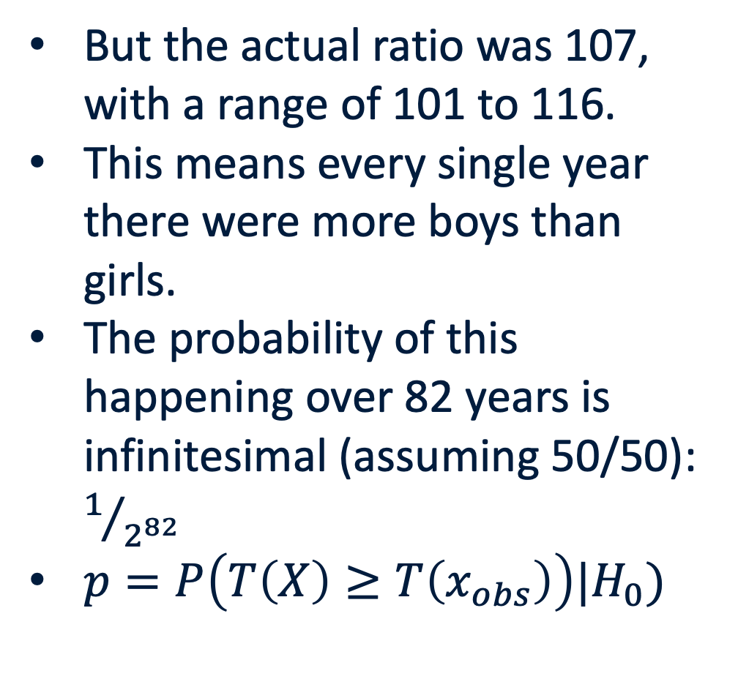
Are more boys born than girls?
But the actual ratio was 107, with a range of 101 to 116.
This means every single year there were more boys than girls.
The probability of this happening over 82 years is infinitesimal (assuming 50/50): $1/{2^{82}}$
$p=P\left(T\left(X\right)≥T\left(x_{obs}\right)\right)|H_{0})$

Slide 6
John Arbuthnot’s Interpretation
Arbuthnot was sure this was divine providence.
Boys went to war and died. So, God made sure there were more boys than girls.
Regardless of his interpretation, Arbuthnot did what we now call a statistical test. He assessed whether the probability was within what would be considered reasonable (which could be for example, the range you may expect from 82 coin tosses).
Indeed, his finding still holds!

Slide 7
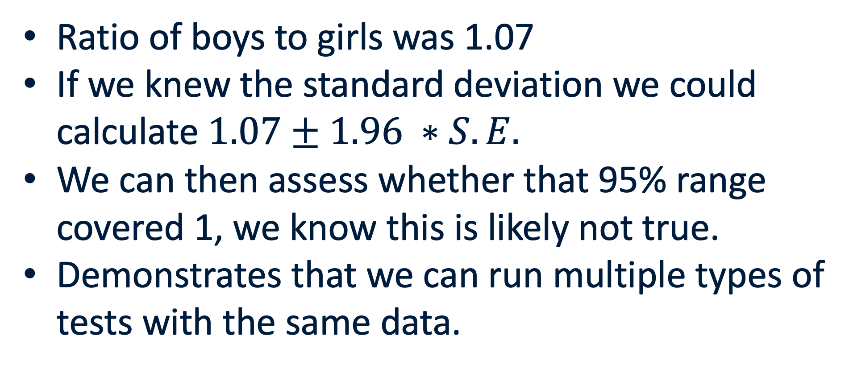
Applying the Central Limit Theorem
Ratio of boys to girls was 1.07
If we knew the standard deviation we could calculate $1.07±1.96 ∗S.E.$
We can then assess whether that 95% range covered 1, we know this is likely not true.
Demonstrates that we can run multiple types of tests with the same data.
Notes:
Pretend you had some values below 1 – re-frame this as calculating the confidence interval for a proportion.

Slide 8
Answering questions with probability
Definition
Hypothesis testing: Assessing whether, given our data and a base expectation (claim that a parameter takes a particular numerical value), we can reject the expectation at some probability. Formally, establishing a null and alternative hypothesis and determining the p-value, with some threshold at which we reject the null.
For Arbuthnot, he rejected the null (our base expectation) of a 50/50 chance of the sex ratio being above 1 given that the probability of that 50/50 chance was so low for his data.

Slide 9
Answering questions with probability
Definition
Hypothesis: A proposed explanation.
A hypothesis is just what we might predict will happen.
It’s not the absolute truth, but instead a provisional, working assumption, until we come up with a better hypothesis.
Newtonian mechanics was a good hypothesis and explained the data really well, until relativity came along.
Remember that some hypotheses can explain the data well but still be not necessarily useful: some hypotheses overfit the data.

Slide 10
How it all comes together for Hypothesis Testing
Data are gathered from randomization, random sampling, etc.
We can visualize data to understand it.
Random sampling enables probability calculations.
Probability calculations enables us to assign a sampling distribution to a parameter of interest.
Hypothesis testing lets us make a decision about the parameter (greater than some value, less than some value, related to another parameter, etc.).

Slide 11
A Brief History of Hypothesis Testing
1925 — Ronald Fisher: Introduces significance testing in “Statistical Methods for Research Workers.” Key tool: the p-value as a measure of evidence against the null hypothesis. No alternative hypothesis required.
1933 — Neyman & Pearson: Publish “On the Problem of the Most Efficient Tests of Statistical Hypotheses.” Key innovations: the alternative hypothesis, Type I and Type II errors, statistical power, and controlled error rates.
Today — A hybrid framework: Researchers report p-values (Fisherian) while designing studies with power and sample-size calculations (Neyman-Pearson). The two founders disagreed bitterly — yet their methods are routinely used together.

Slide 12
Answering questions with probability
Does taking statins reduce the risk of heart attacks and strokes in the elderly?
Null hypothesis: Statins do nothing for heart attacks and strokes.
Alternative hypothesis: Statins do in fact alter heart attack/stroke rates, the hypothesis being in the direction of reduction.
Does the Higg’s boson exist?
Null hypothesis: No, it does not exist.
Alternative: The Higg’s boson exists.

Slide 13
Answering questions with probability
To be able to reject the null hypotheses about statins and the Higg’s boson’s existence, we need some way to test the hypothesis.
Essentially, we need to be able to say, that at some level of certainty (i.e. probability), we don’t believe the null hypothesis is true.
We don’t make decisions without being confident that they are approximately the right one. We want to do that for hypotheses.
Also remember, we can never prove the null hypothesis, we can however disprove it with experiments.

Slide 14
Why can’t we prove the null?
The null is an assumption, there is no data that exists to support it.
Instead, we check whether, given the null, how unlikely is the data we actually have?
This is akin to assuming that a defendant in a court case is innocent but rejecting that based on the evidence that they are guilty.
We aren’t out to prove they are innocent, just guilty or not guilty == “reject or don’t reject the null hypothesis”.

Slide 15
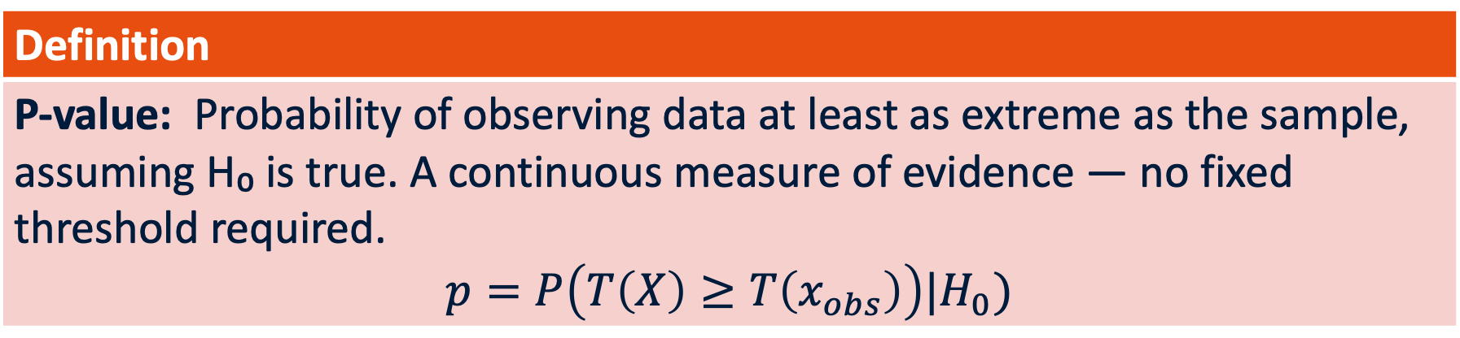
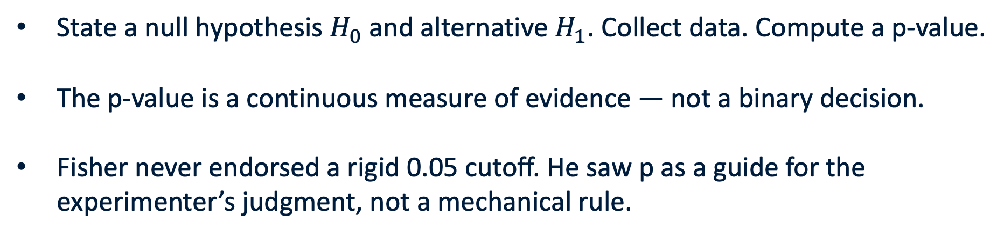
Significance Testing
Definition
P-value: Probability of observing data at least as extreme as the sample, assuming H₀ is true. A continuous measure of evidence — no fixed threshold required. $$p=P\left(T\left(X\right)≥T\left(x_{obs}\right)\right)|H_{0})$$
State a null hypothesis $H_{0}$ and alternative $H_{1}$. Collect data. Compute a p-value.
The p-value is a continuous measure of evidence — not a binary decision.
Fisher never endorsed a rigid 0.05 cutoff. He saw p as a guide for the experimenter’s judgment, not a mechanical rule.

Slide 16
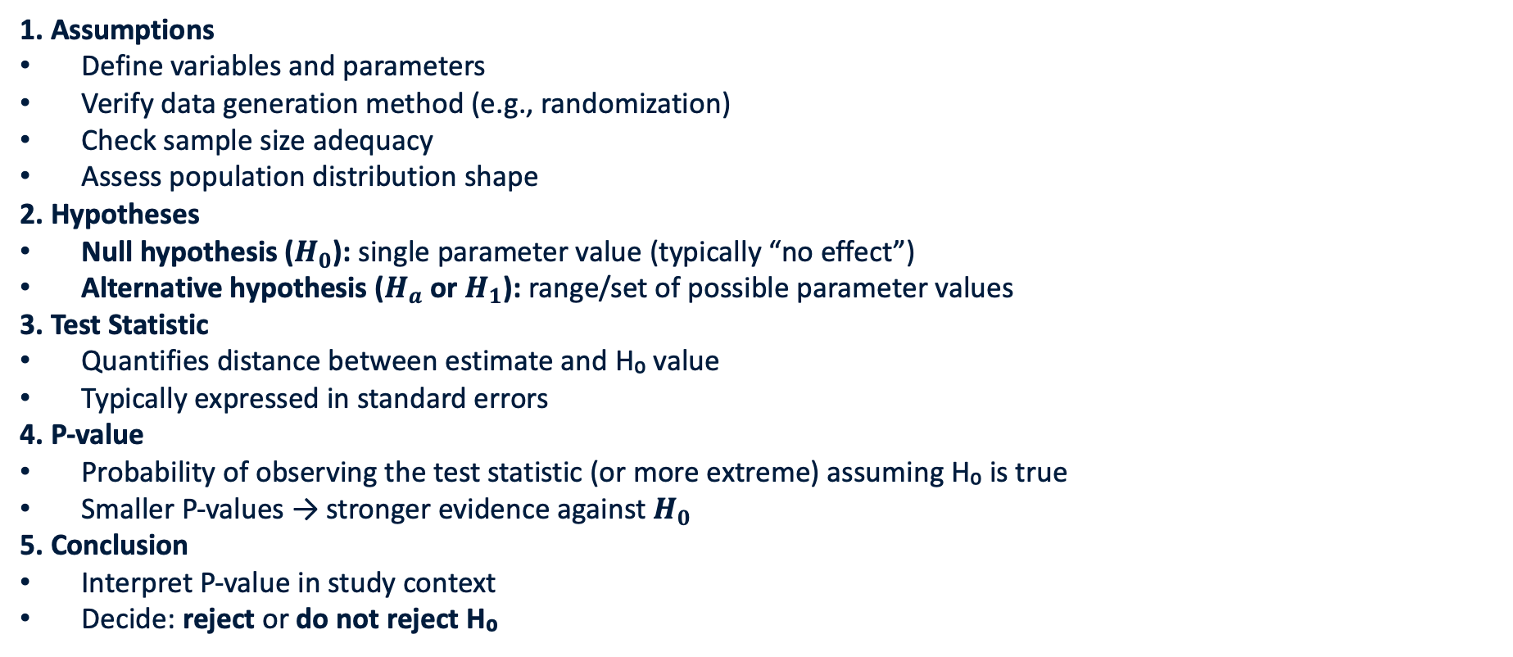
Steps of Hypothesis Testing
1. Assumptions
Define variables and parameters
Verify data generation method (e.g., randomization)
Check sample size adequacy
Assess population distribution shape
2. Hypotheses
Null hypothesis ($H_{0}$): single parameter value (typically “no effect”)
Alternative hypothesis ($H_{a}$ or $H_{1}$): range/set of possible parameter values
3. Test Statistic
Quantifies distance between estimate and H₀ value
Typically expressed in standard errors
4. P-value
Probability of observing the test statistic (or more extreme) assuming H₀ is true
Smaller P-values → stronger evidence against $H_{0}$
5. Conclusion
Interpret P-value in study context
Decide: reject or do not reject H₀

Slide 17
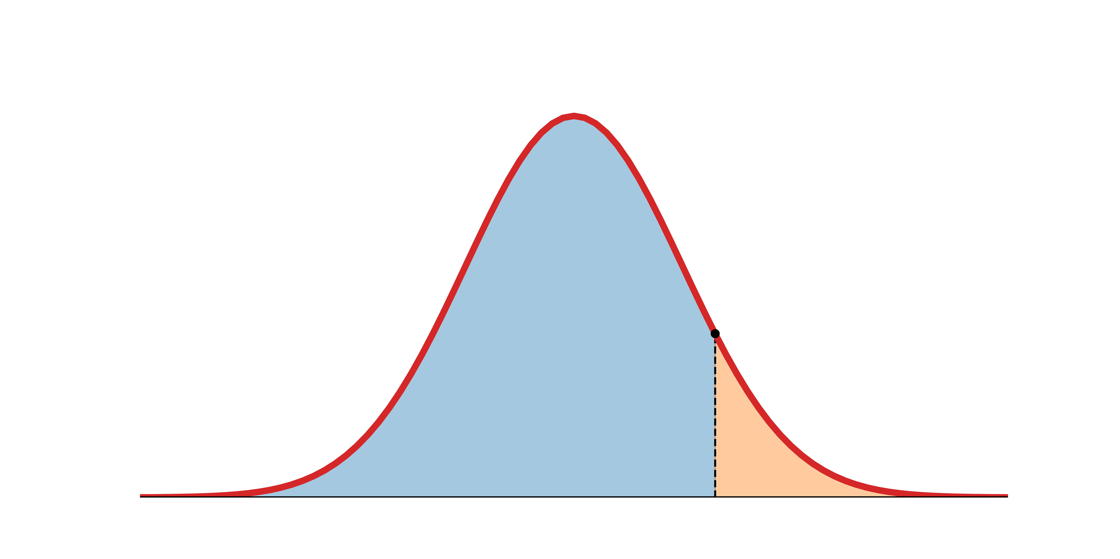

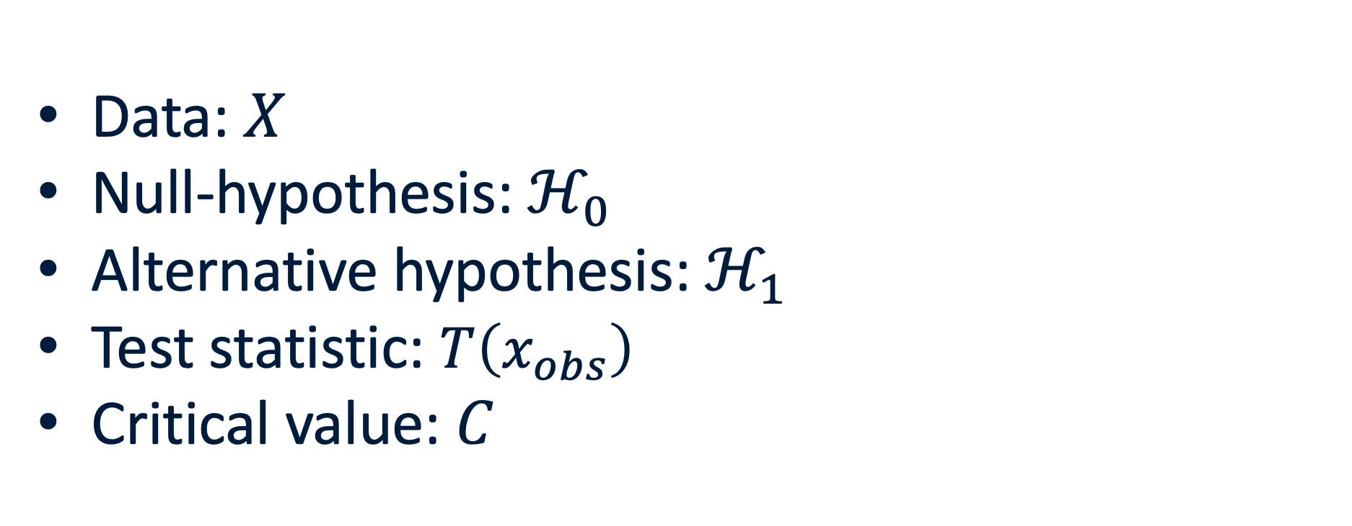


Statistical Significance and Hypothesis Testing
Data: $X$
Null-hypothesis: $ℋ_{0}$
Alternative hypothesis: $ℋ_{1}$
Test statistic: $T\left(x_{obs}\right)$
Critical value: $C$
$$c$$
Fail to reject $𝓗_{0}$
Reject $𝓗_{0}$ in favor of $ℋ_{1}$

Slide 18

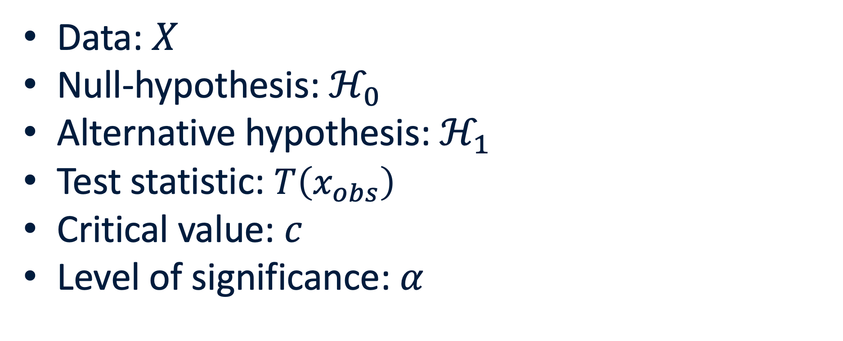

Hypothesis testing
Data: $X$
Null-hypothesis: $ℋ_{0}$
Alternative hypothesis: $ℋ_{1}$
Test statistic: $T\left(x_{obs}\right)$
Critical value: $c$
Level of significance: $α$
$$α$$
$$c$$

Slide 19
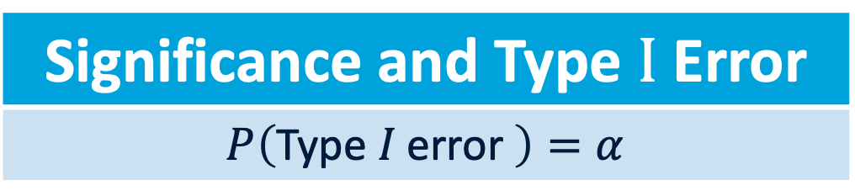
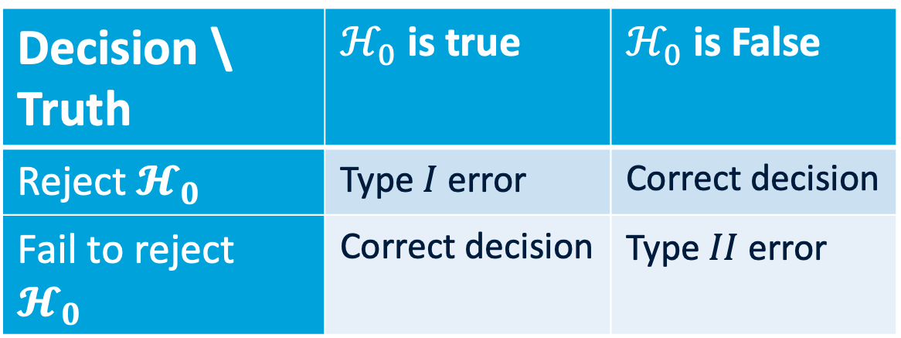

Hypothesis testing
Decision \ Truth | $ℋ_{0}$ is true | $ℋ_{0}$ is False
Reject $𝓗_{0}$ | Type $I$ error | Correct decision
Fail to reject $𝓗_{0}$ | Correct decision | Type $II$ error
Data: $X$
Null-hypothesis: $ℋ_{0}$
Alternative hypothesis: $ℋ_{1}$
Test statistic: $T\left(x_{obs}\right)$
Critical value: $c$
Level of significance: $α$
$$Θ$$
$$α$$
$$c$$
Significance and Type $I$ Error
$$P\left(\text{Type} I \text{error} \right)=α$$

Slide 20
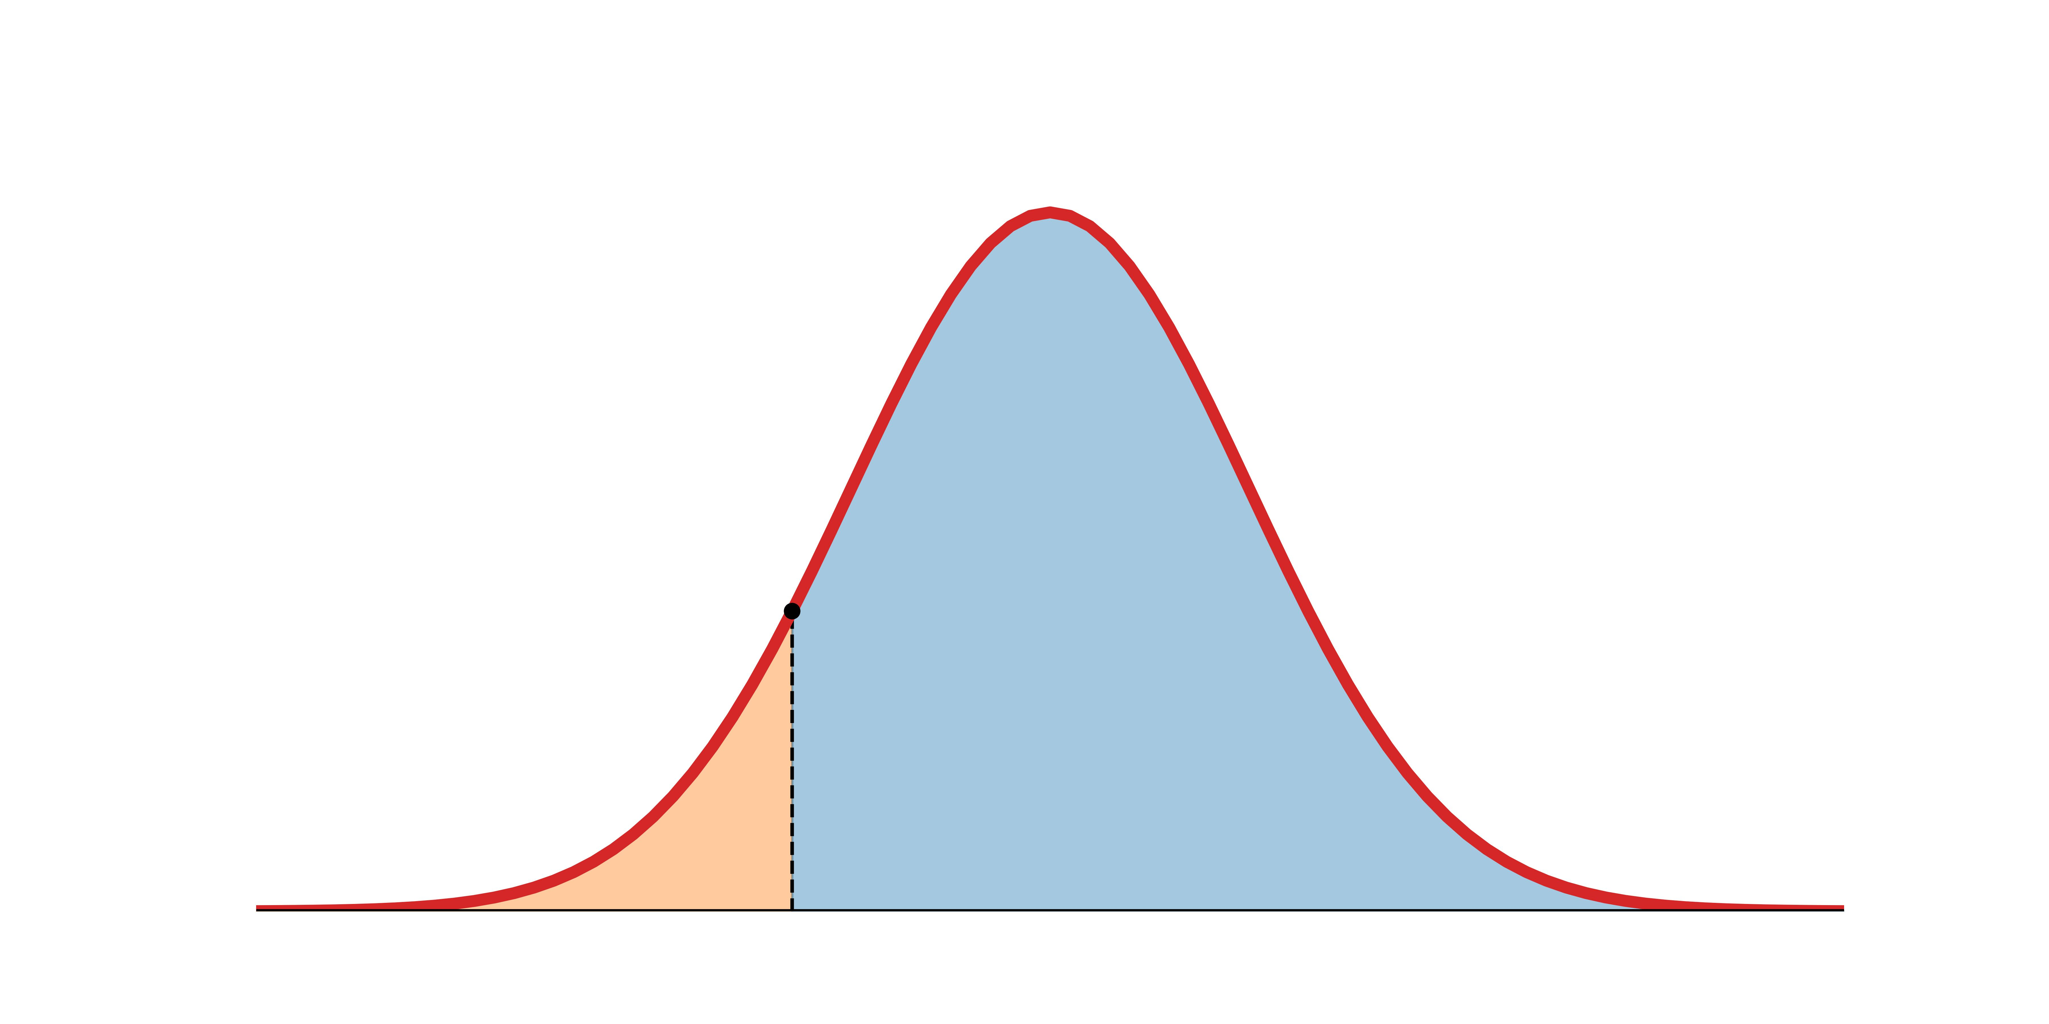
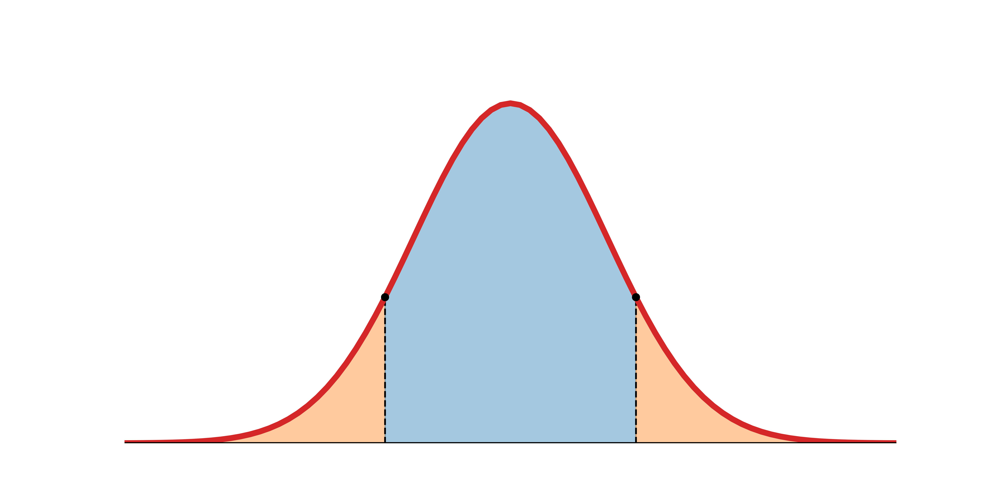




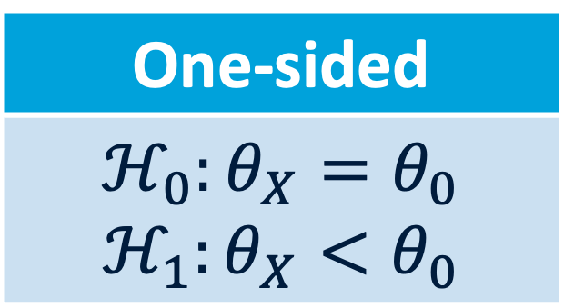

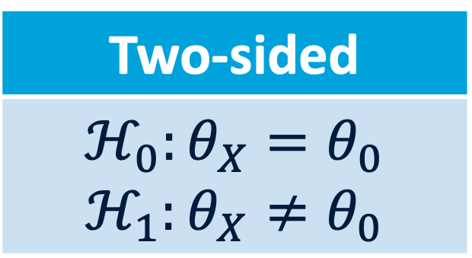
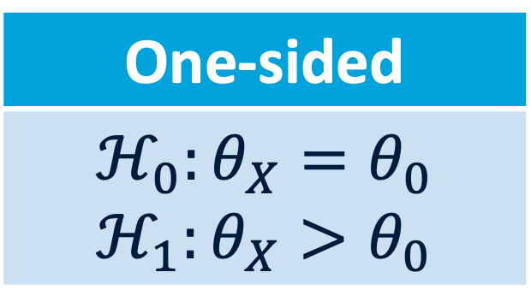

One-tailed vs two-tailed hypothesis testing
One-sided
$$ℋ_{0}:θ_{X}=θ_{0}$$ $$ℋ_{1}:θ_{X}<θ_{0}$$
Two-sided
$$ℋ_{0}:θ_{X}=θ_{0}$$ $$ℋ_{1}:θ_{X}≠θ_{0}$$
One-sided
$$ℋ_{0}:θ_{X}=θ_{0}$$ $$ℋ_{1}:θ_{X}>θ_{0}$$
$$Θ$$
$$Θ$$
$$Θ$$
$$c$$
$$c$$
$$c$$
$$c$$
Critical region
Critical region
Critical region
Notes:
Designing a null- and alternative hypothesis

Slide 21
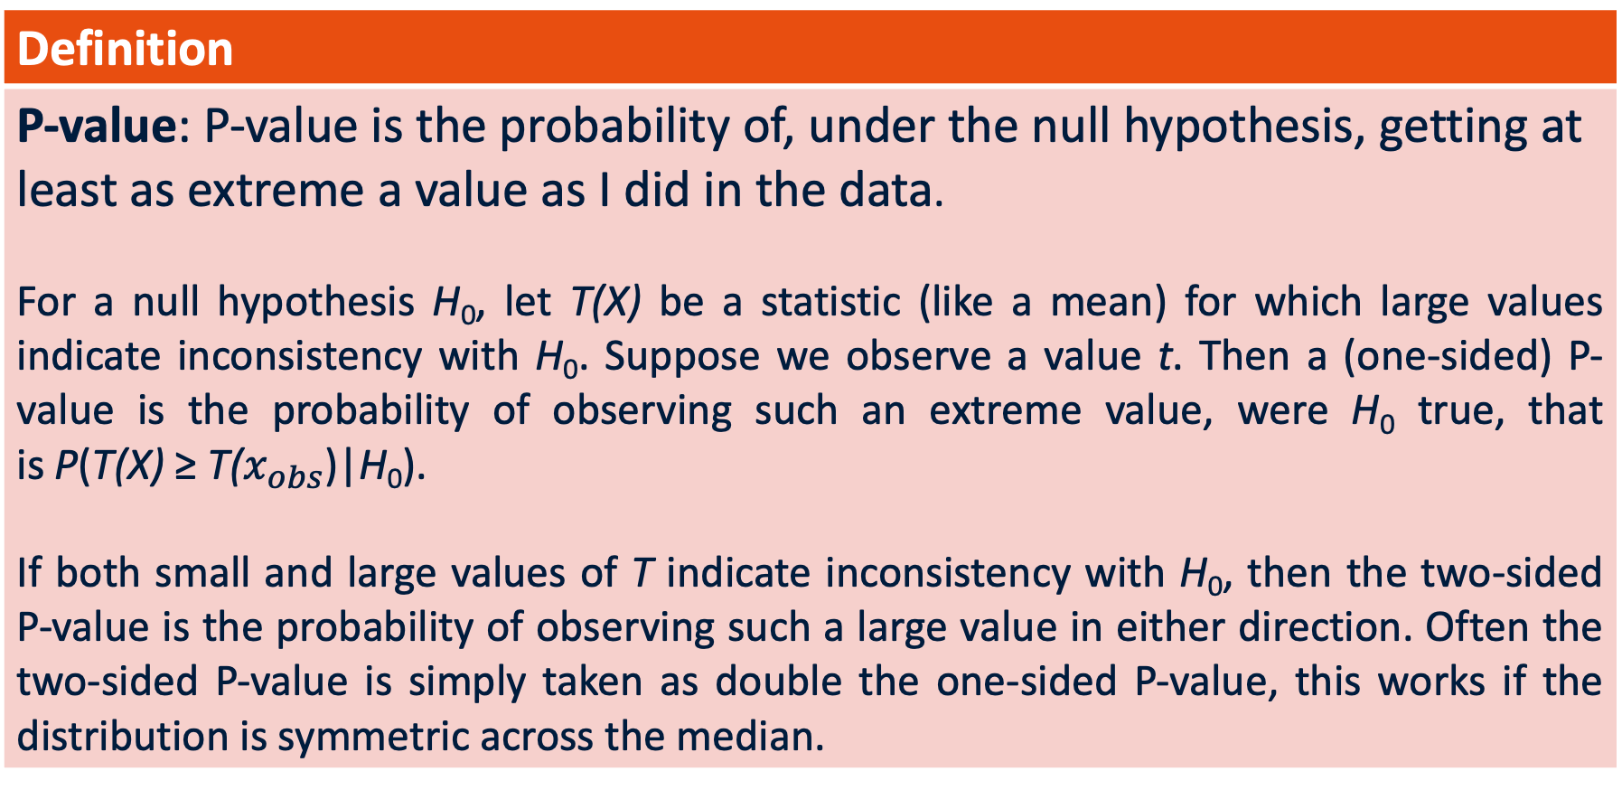
What is a P-value?
Definition
P-value: P-value is the probability of, under the null hypothesis, getting at least as extreme a value as I did in the data. For a null hypothesis H₀, let T(X) be a statistic (like a mean) for which large values indicate inconsistency with H₀. Suppose we observe a value t. Then a (one-sided) P-value is the probability of observing such an extreme value, were H₀ true, that is P(T(X) ≥ T($x_{obs}$)|H₀). If both small and large values of T indicate inconsistency with H₀, then the two-sided P-value is the probability of observing such a large value in either direction. Often the two-sided P-value is simply taken as double the one-sided P-value, this works if the distribution is symmetric across the median.

Slide 22
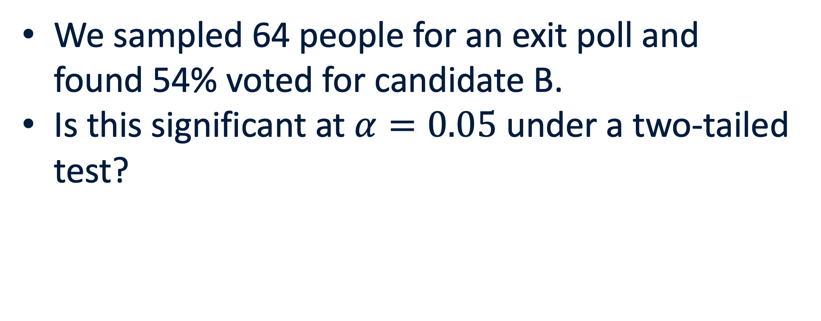
P-values for a Proportion: Example
We sampled 64 people for an exit poll and found 54% voted for candidate B.
Is this significant at $α=0.05$ under a two-tailed test?

Slide 23
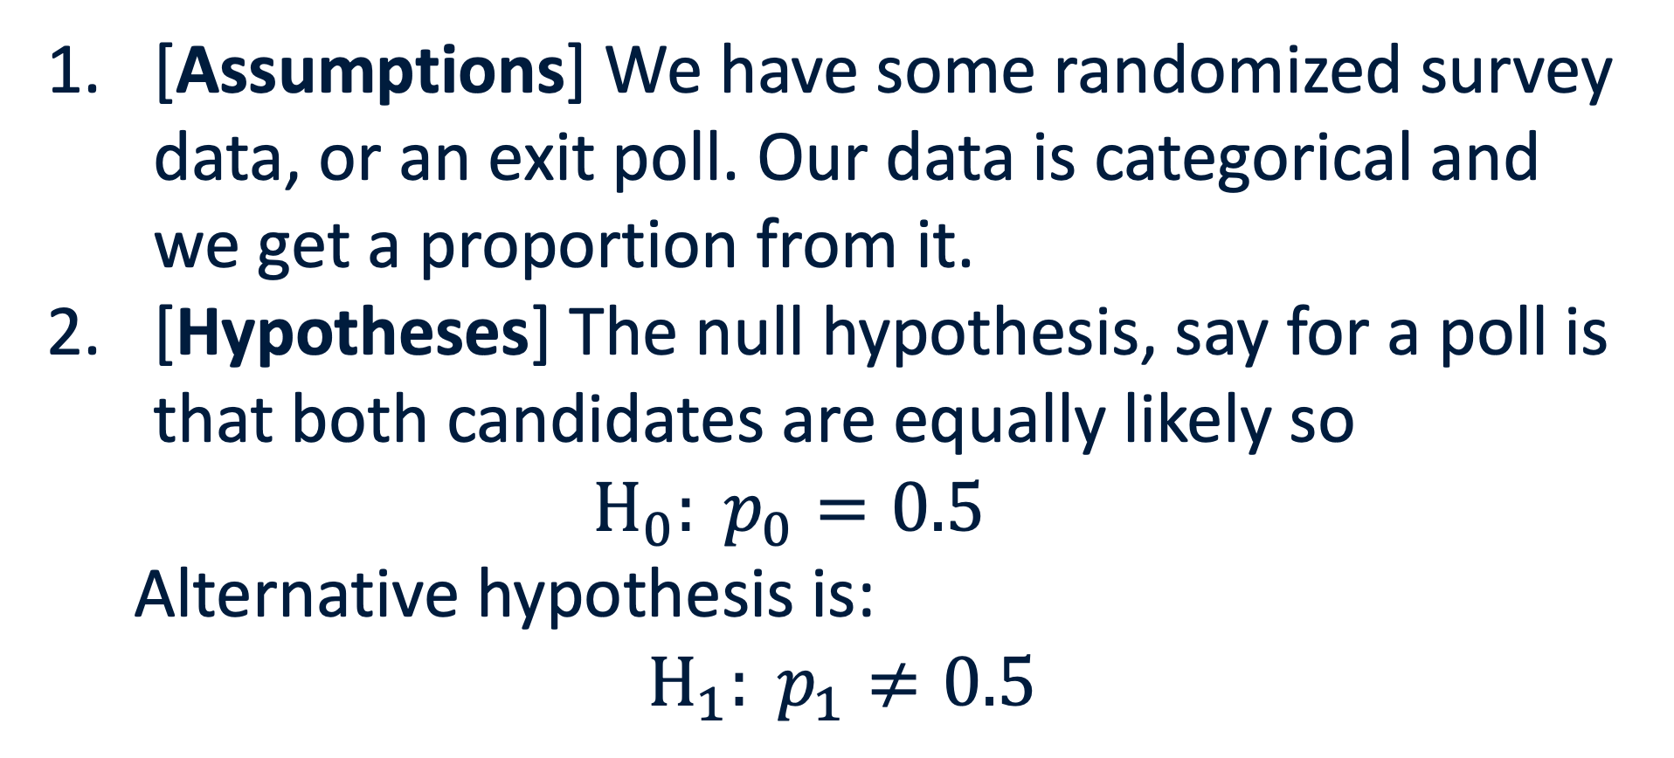
P-values for a Proportion
[Assumptions] We have some randomized survey data, or an exit poll. Our data is categorical and we get a proportion from it.
[Hypotheses] The null hypothesis, say for a poll is that both candidates are equally likely so $H_{0}: p_{0}=0.5$
Alternative hypothesis is: $$H_{1}: p_{1}≠0.5$$

Slide 24
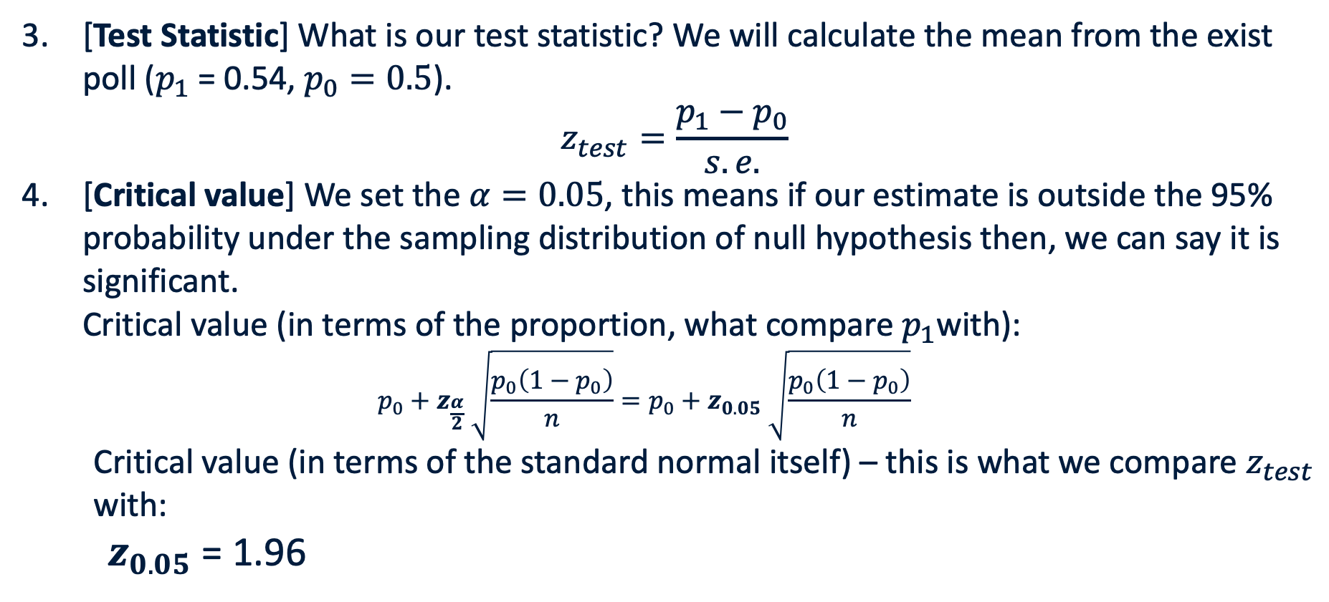
P-values for a Proportion (two-tailed)
[Test Statistic] What is our test statistic? We will calculate the mean from the exist poll ($p_{1}$= 0.54, $p_{0}=0.5$).
$$z_{test}=\frac{p_{1}−p_{0}}{s.e.}$$
[Critical value] We set the $α=0.05$, this means if our estimate is outside the 95% probability under the sampling distribution of null hypothesis then, we can say it is significant. Critical value (in terms of the proportion, what compare $p_{1}$with): $p_{0}+z_{\frac{α}{2}} \sqrt{\frac{p_{0}\left(1−p_{0}\right)}{n}}=p_{0}+z_{0.05} \sqrt{\frac{p_{0}\left(1−p_{0}\right)}{n}}$
Critical value (in terms of the standard normal itself) – this is what we compare $z_{test}$ with:
$z_{0.05}$ = 1.96

Slide 25
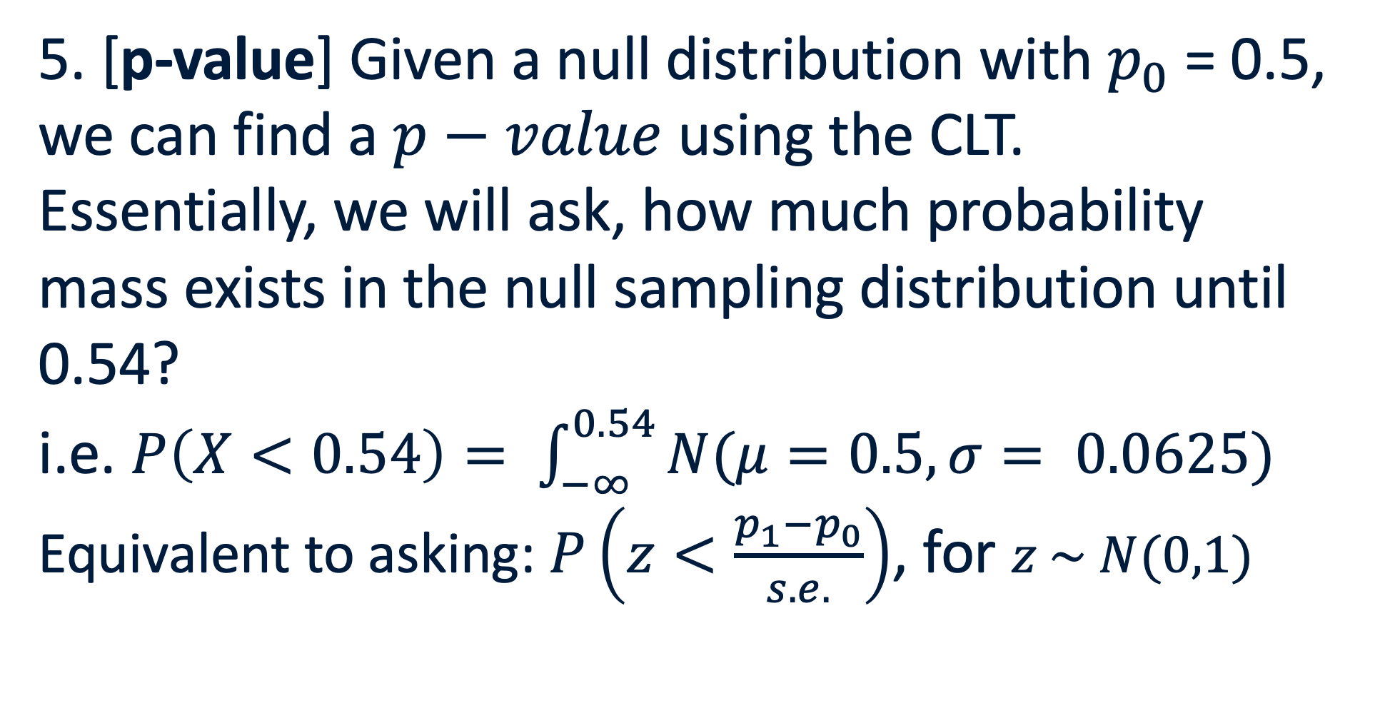
P-values for a Proportion (two-tailed)
5. [p-value] Given a null distribution with $p_{0}$ = 0.5, we can find a $p−value$ using the CLT.
Essentially, we will ask, how much probability mass exists in the null sampling distribution until 0.54?
i.e. $P\left(X<0.54\right)= \int_{−∞}^{0.54}{N(μ=0.5, σ= 0.0625)}$
Equivalent to asking: $P\left(z<\frac{p_{1}−p_{0}}{s.e.}\right)$, for $z \sim N(0,1)$

Slide 26


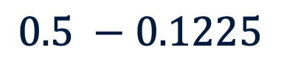
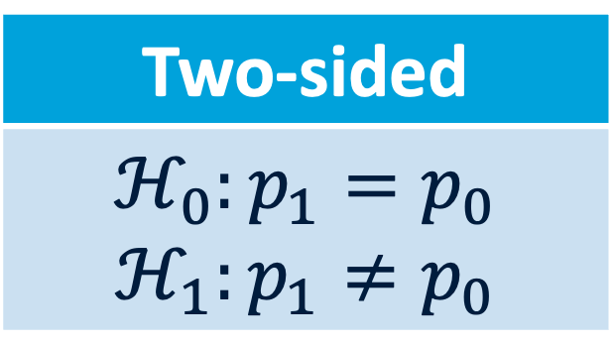

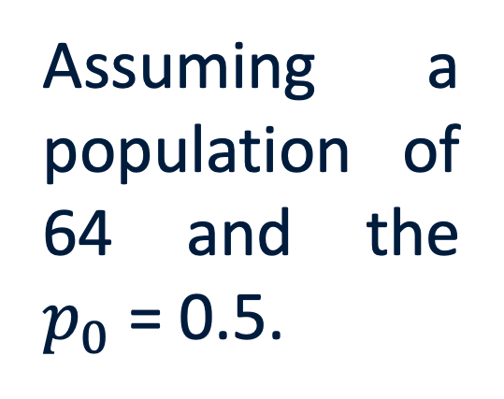
Two-tailed hypothesis testing: Conclusion
Two-sided
$$ℋ_{0}:p_{1}=p_{0}$$ $$ℋ_{1}:p_{1}≠p_{0}$$
Assuming a population of 64 and the $p_{0}$ = 0.5.
$$Θ$$
$p_{1}$ = 0.54
$$0.5 −0.1225$$
$$0.5+0.1225$$
$$p_{0}$$
Critical region
Notes:
For an assumed population of 64, and p0 = 0.5

Slide 27
The CONDOMS checklist for Hypothesis Testing
C – Clarify the research question before running any tests or looking at results.
O – Operationalize the variables.
N – Null and alternative hypotheses.
D – Design: Independent, paired, repeated, randomized?
O – Observe the data before testing.
M – Match the test to the variable types and assumptions.
S – State the result accurately.
Why? Because just like you were taught in sex-ed, you should always protect yourself against bad outcomes.
Notes:
Why? Because, just like in sex-ed, I want you to know how to use the right protection before you do anything.

Slide 28
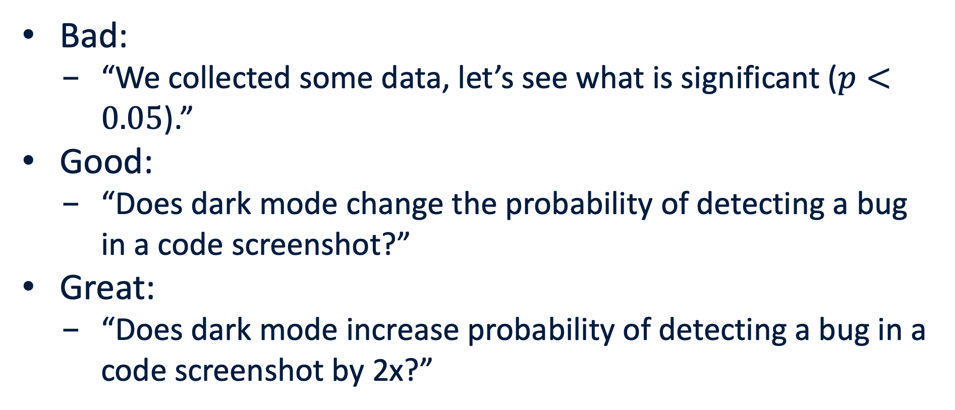
C – Clarify the research question
Bad:
“We collected some data, let’s see what is significant ($p<0.05$).”
Good:
“Does dark mode change the probability of detecting a bug in a code screenshot?”
Great:
“Does dark mode increase probability of detecting a bug in a code screenshot by 2x?”

Slide 29
O – what is the Outcome variable?
Concept | Outcome variable
Code readability | time to correct answer
UI error detection | correct/incorrect detection
Restaurant appeal | 1–7 rating
Ranking disagreement | rank order / agreement score

Slide 30
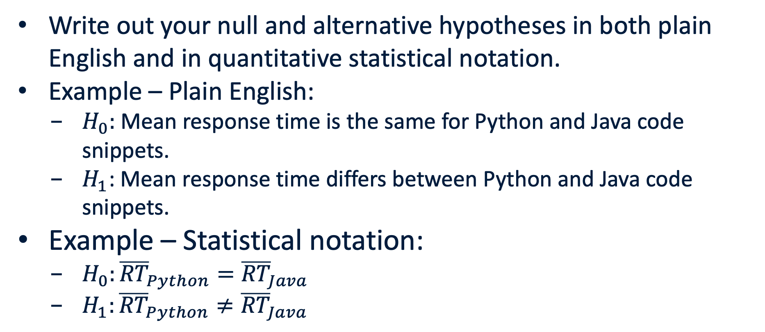
N – Null and alternative hypotheses.
Write out your null and alternative hypotheses in both plain English and in quantitative statistical notation.
Example – Plain English:
$H_{0}:$Mean response time is the same for Python and Java code snippets.
$H_{1}$: Mean response time differs between Python and Java code snippets.
Example – Statistical notation:
$H_{0}:{\overline{RT}}_{Python}={\overline{RT}}_{Java}$
$H_{1}:{\overline{RT}}_{Python}≠{\overline{RT}}_{Java}$

Slide 31
D – Design: Independent, paired, repeated, randomized?
Are the groups you have made of different people or did the same person experience both conditions?
Independent: distinct people in groups
Pairs: same people in both groups
Repeated: same people tested multiple times
Randomized: distinct and randomly assigned people in groups

Slide 32
O – Observe the data before testing.
Before running any test, visualize your data and:
Check for missing data (and fill it in, with a mean/median/more complex approach)
Check for impossible values
Count group sizes
Inspect potential outliers and decide what to do about them (justify this!)

Slide 33
M – Match the test to the variable types and assumptions.
Depending on variable types (numeric/count/etc.)
Depending on the design (independent or paired)
Depending on research question
Choose the correct test!

Slide 34
S – State the result accurately.
Every result you present should include:
Descriptive statistic value
Test statistic value
Degrees of freedom, when relevant
P-value
Confidence limits (when possible)
Plain English interpretation
E.g. Mean rection time difference was 1.5 s (paired t-test p<0.05, df = 12, t= xyz, [1.0,2.0]) suggesting Python was quicker judged than Java.

Slide 35
M – Match the test
Research question type | Outcome | Predictor / groups | Typical test | What to visualize
Do two independent groups differ? | Numeric | 2 independent groups | Welch two-sample t-test | boxplot/violin + points
Do the same people differ across two conditions? | Numeric | 2 paired measurements | Paired t-test | paired line plot
Do 3+ groups differ? | Numeric | 3+ groups | One-way ANOVA, F-test | boxplot by group
Are two categorical variables associated? | Categorical | Categorical | Chi-square test of independence | contingency table / stacked bar
Does observed category frequency match expectation? | Counts | Expected proportions | Chi-square goodness-of-fit | observed vs expected bar chart
Do two groups have different variances? | Numeric | 2 groups | F-test for variance, but be cautious | distribution/boxplot
Are ordinal/ranked responses different? | Ordinal/ranks | Groups or conditions | Mann–Whitney / Wilcoxon / Kruskal–Wallis | dot/box/rank plot
Is a numeric outcome related to a numeric predictor? | Numeric | Numeric | Correlation / regression F-test | scatterplot

Slide 36
M- Match the test
If you believe that your data does not satisfy any of the potential tests.
Or you use a descriptive statistic that cannot be tested in the ways described.
Then you can always do a bootstrap test!
Resample from your dataset appropriately, re-calculate your statistics and assess significance.

Slide 37

Fill out the following for your experiment:

Slide 38
Potential limitations
Too little data
Data isn’t truly continuous across full real line
Data is skewed and there’s too little data for CLT to kick in for the mean
Make sure to note the limitations in your report!

Slide 39
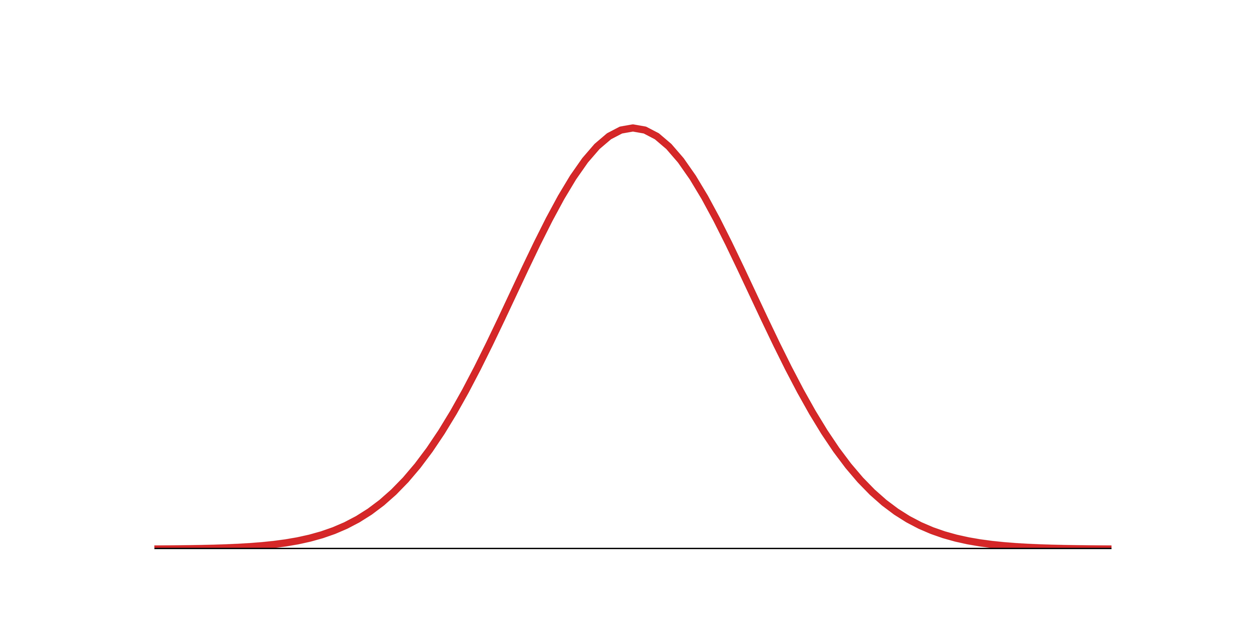
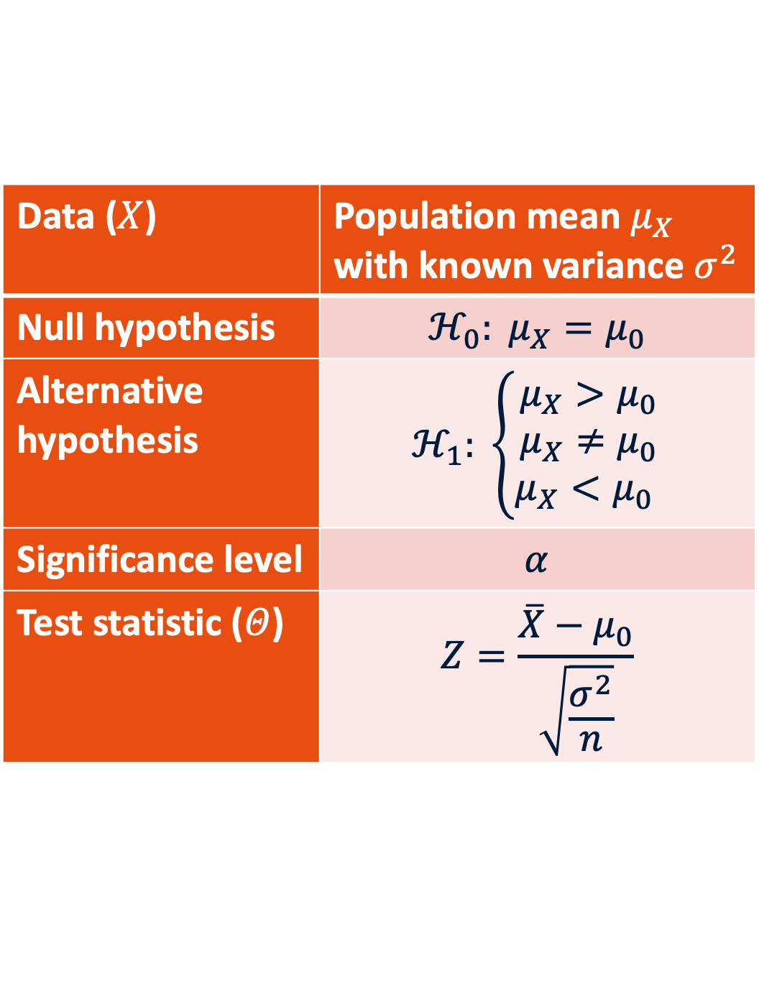
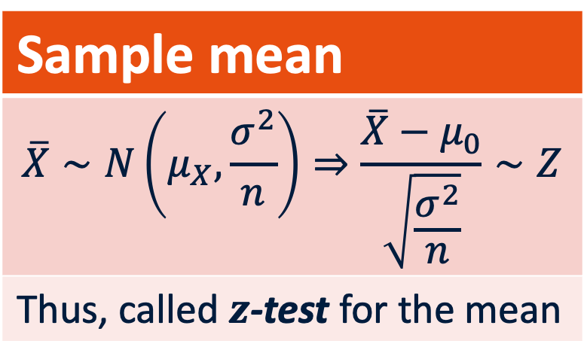
P-values for the mean (treat as reaction time)
$$Θ$$
Data ($X$) | Population mean $μ_{X}$ with known variance $σ^{2}$
Null hypothesis | $$ℋ_{0}: μ_{X}=μ_{0}$$
Alternative hypothesis | $$ℋ_{1}: \left\{\begin{aligned}μ_{X}>μ_{0} \\ μ_{X}≠μ_{0} \\ μ_{X}<μ_{0} \end{aligned}\right.$$
Significance level | $$α$$
Test statistic ($Θ$) | $$Z=\frac{\overline{X}−μ_{0}}{\sqrt{\frac{σ^{2}}{n}}}$$
Sample mean
$$\overline{X}∼N\left(μ_{X},\frac{σ^{2}}{n}\right)⇒\frac{\overline{X}−μ_{0}}{\sqrt{\frac{σ^{2}}{n}}}∼Z$$
Thus, called $z$-test for the mean
Notes:
Identify standard error.
Identify the confidence interval hiding in plain sight.

Slide 40
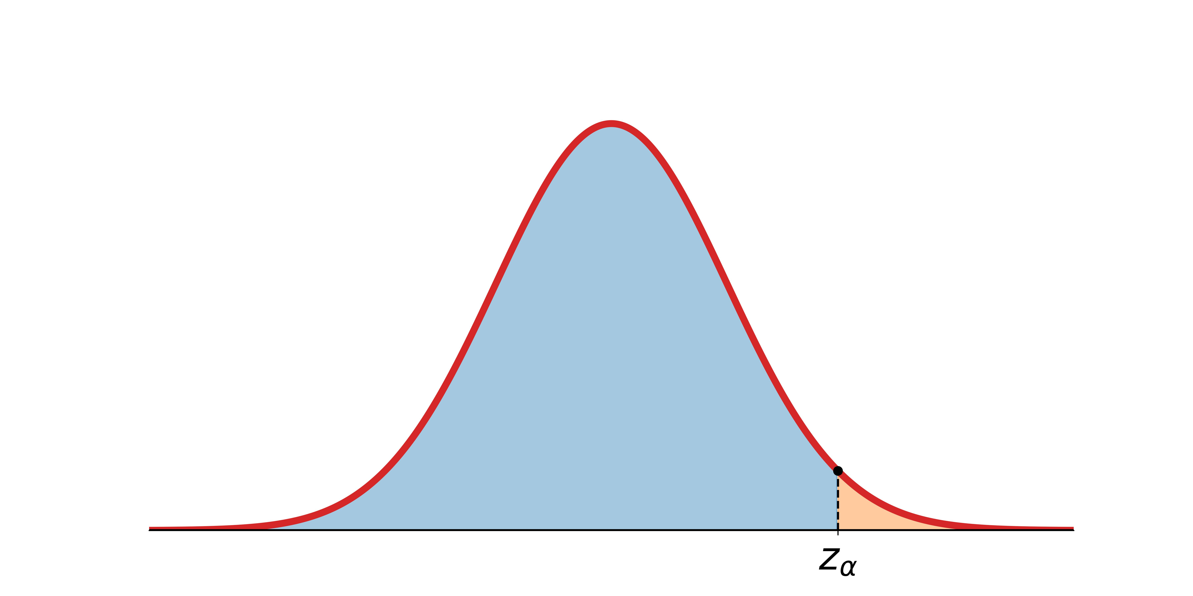
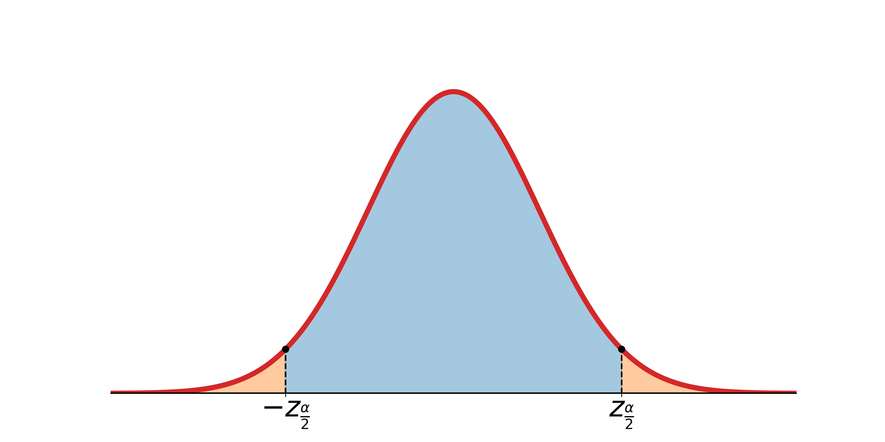
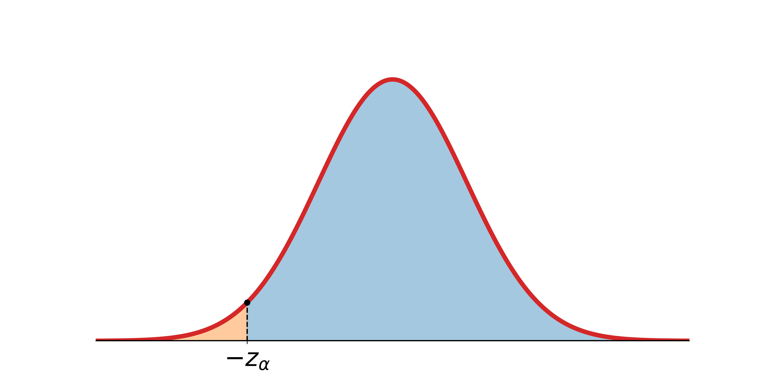
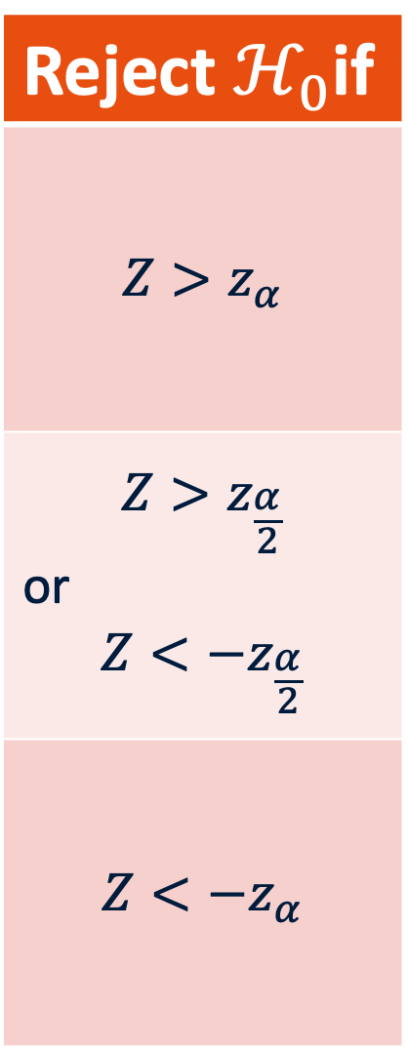


P-values for the mean
Reject $ℋ_{0}$if
$$Z>z_{α}$$
$$Z>z_{\frac{α}{2}}$$ or $$Z<−z_{\frac{α}{2}}$$
$$Z<−z_{α}$$
$$Θ$$
Data ($X$) | Population mean $μ_{X}$ with known variance $σ^{2}$
Null hypothesis | $$ℋ_{0}: μ_{X}=μ_{0}$$
Alternative hypothesis | $$ℋ_{1}: \left\{\begin{aligned}μ_{X}>μ_{0} \\ μ_{X}≠μ_{0} \\ μ_{X}<μ_{0} \end{aligned}\right.$$
Significance level | $$α$$
Test statistic ($Θ$) | $$Z=\frac{\overline{X}−μ_{0}}{\sqrt{\frac{σ^{2}}{n}}}$$
$$Θ$$
$$Θ$$
Notes:
Highlight relationship to confidence interval!

Slide 41
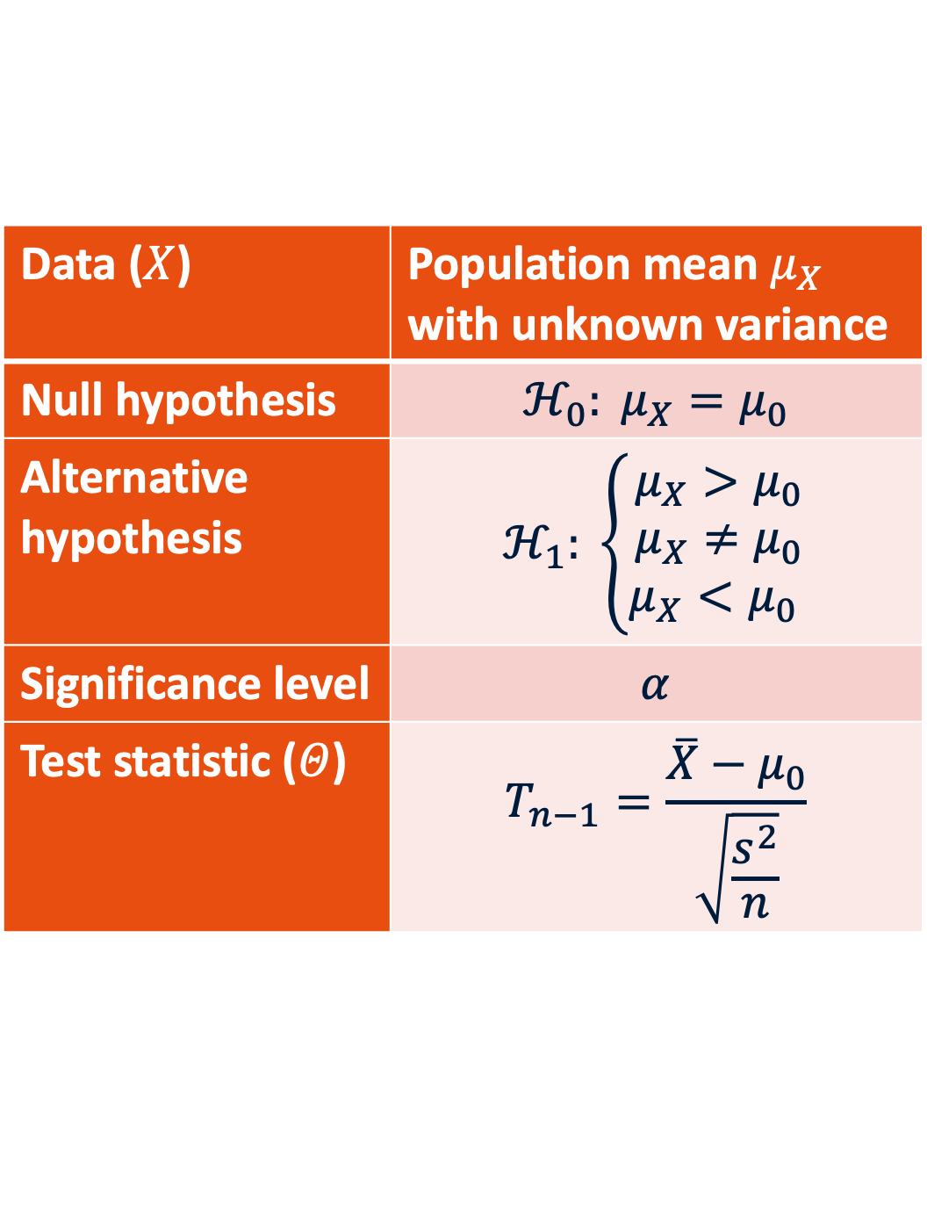
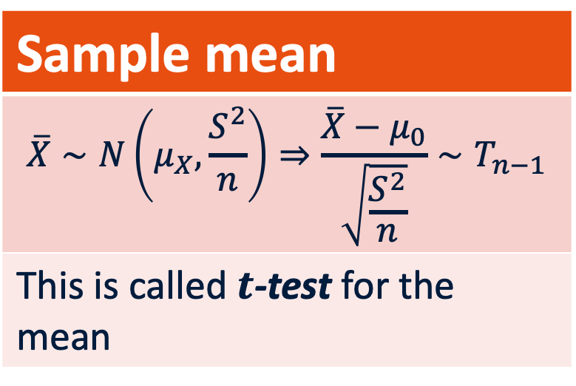
P-values for the mean (SD unknown, <30 samples)
$$Θ$$
Data ($X$) | Population mean $μ_{X}$ with unknown variance
Null hypothesis | $$ℋ_{0}: μ_{X}=μ_{0}$$
Alternative hypothesis | $$ℋ_{1}: \left\{\begin{aligned}μ_{X}>μ_{0} \\ μ_{X}≠μ_{0} \\ μ_{X}<μ_{0} \end{aligned}\right.$$
Significance level | $$α$$
Test statistic ($Θ$) | $$T_{n−1}=\frac{\overline{X}−μ_{0}}{\sqrt{\frac{s^{2}}{n}}}$$
Sample mean
$$\overline{X}∼N\left(μ_{X},\frac{S^{2}}{n}\right)⇒\frac{\overline{X}−μ_{0}}{\sqrt{\frac{S^{2}}{n}}}∼T_{n−1}$$
This is called $t$-test for the mean
Notes:
Identify standard error.
Identify the confidence interval hiding in plain sight.

Slide 42
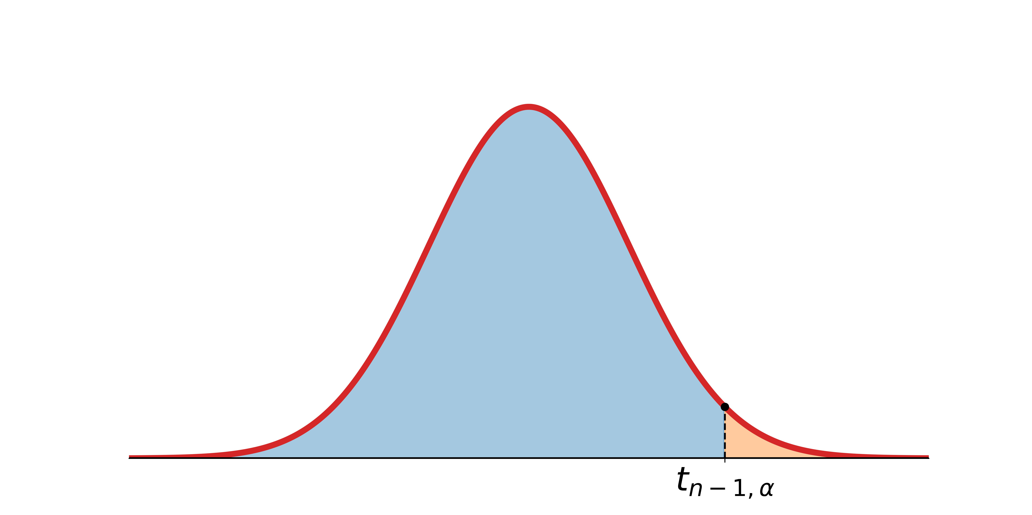
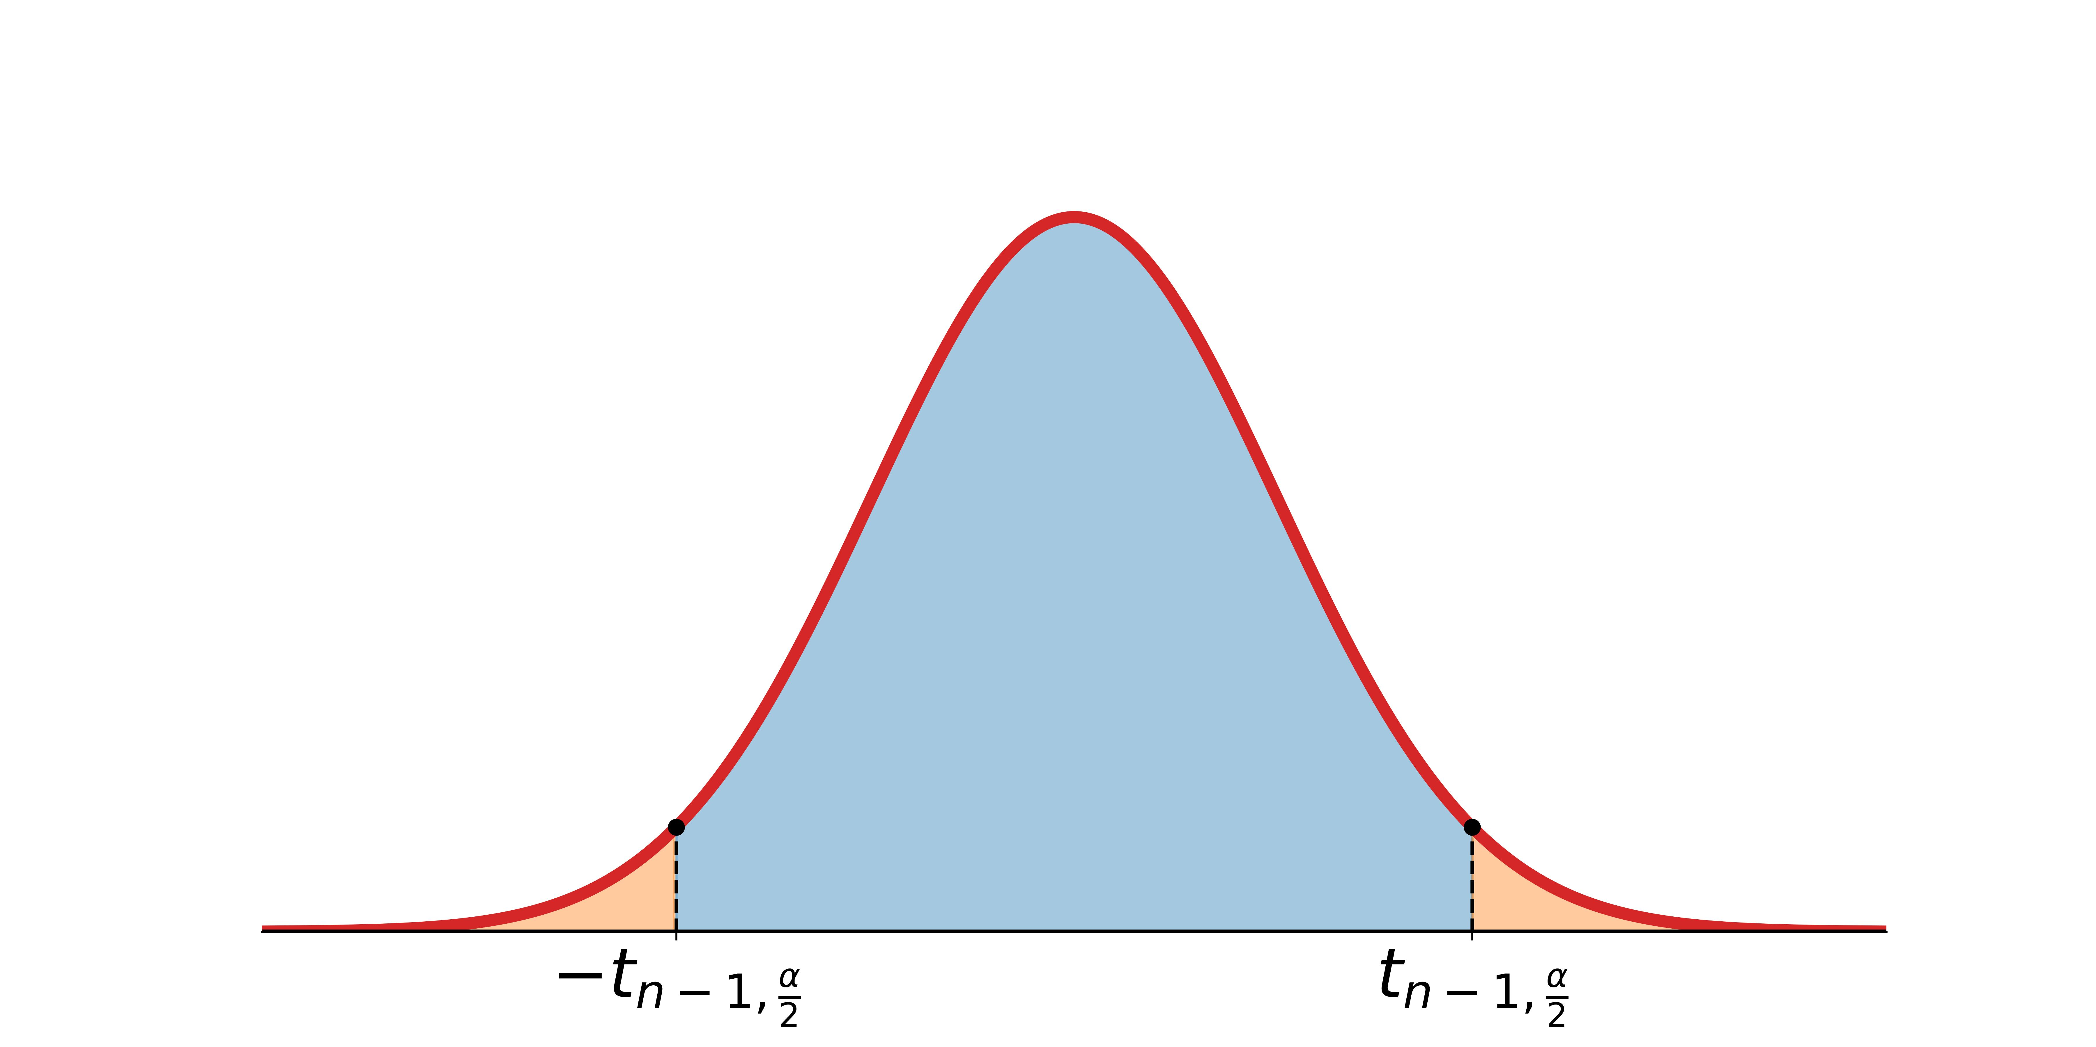
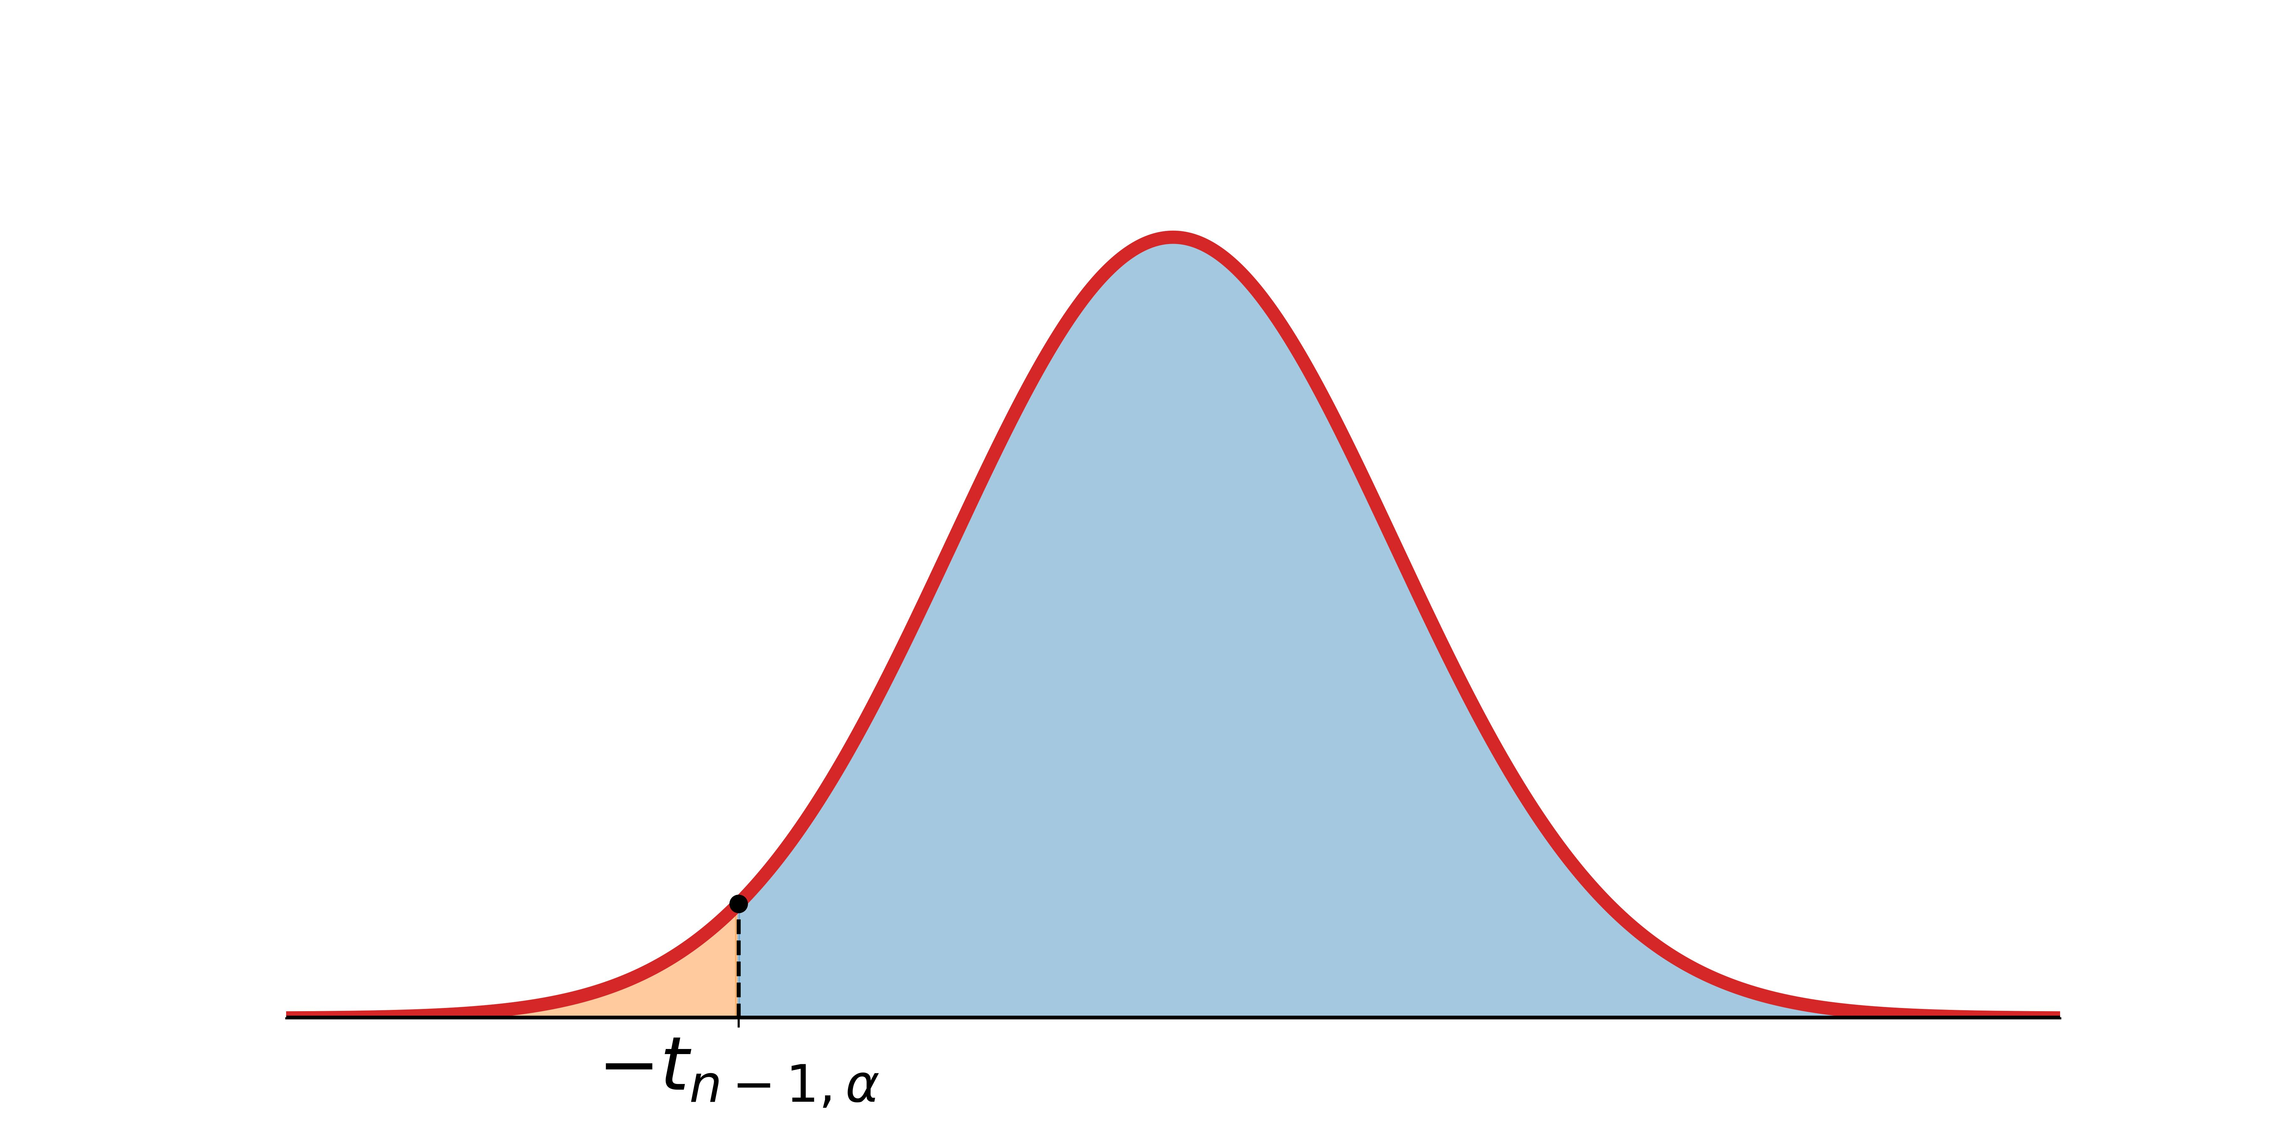
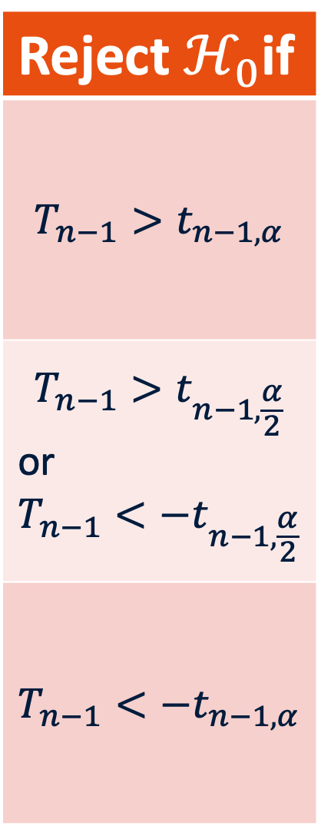
P-values for the mean
Reject $ℋ_{0}$if
$$T_{n−1}>t_{n−1,α}$$
$$T_{n−1}>t_{n−1,\frac{α}{2}}$$ or $$T_{n−1}<−t_{n−1,\frac{α}{2}}$$
$$T_{n−1}<−t_{n−1,α}$$
$$Θ$$
Data ($X$) | Population mean $μ_{X}$ with unknown variance
Null hypothesis | $$ℋ_{0}: μ_{X}=μ_{0}$$
Alternative hypothesis | $$ℋ_{1}: \left\{\begin{aligned}μ_{X}>μ_{0} \\ μ_{X}≠μ_{0} \\ μ_{X}<μ_{0} \end{aligned}\right.$$
Significance level | $$α$$
Test statistic ($Θ$) | $$T_{n−1}=\frac{\overline{X}−μ_{0}}{\sqrt{\frac{s^{2}}{n}}}$$
$$Θ$$
$$Θ$$

Slide 43
Example 1: Numeric Outcome, two groups
Research Q: Do students find Python code more readeable than Java code?
Outcome: Time to correct answer, continuous positive-valued variable, in seconds
Groups: Python vs Java
Test: Welch t-test if independent groups

Slide 44
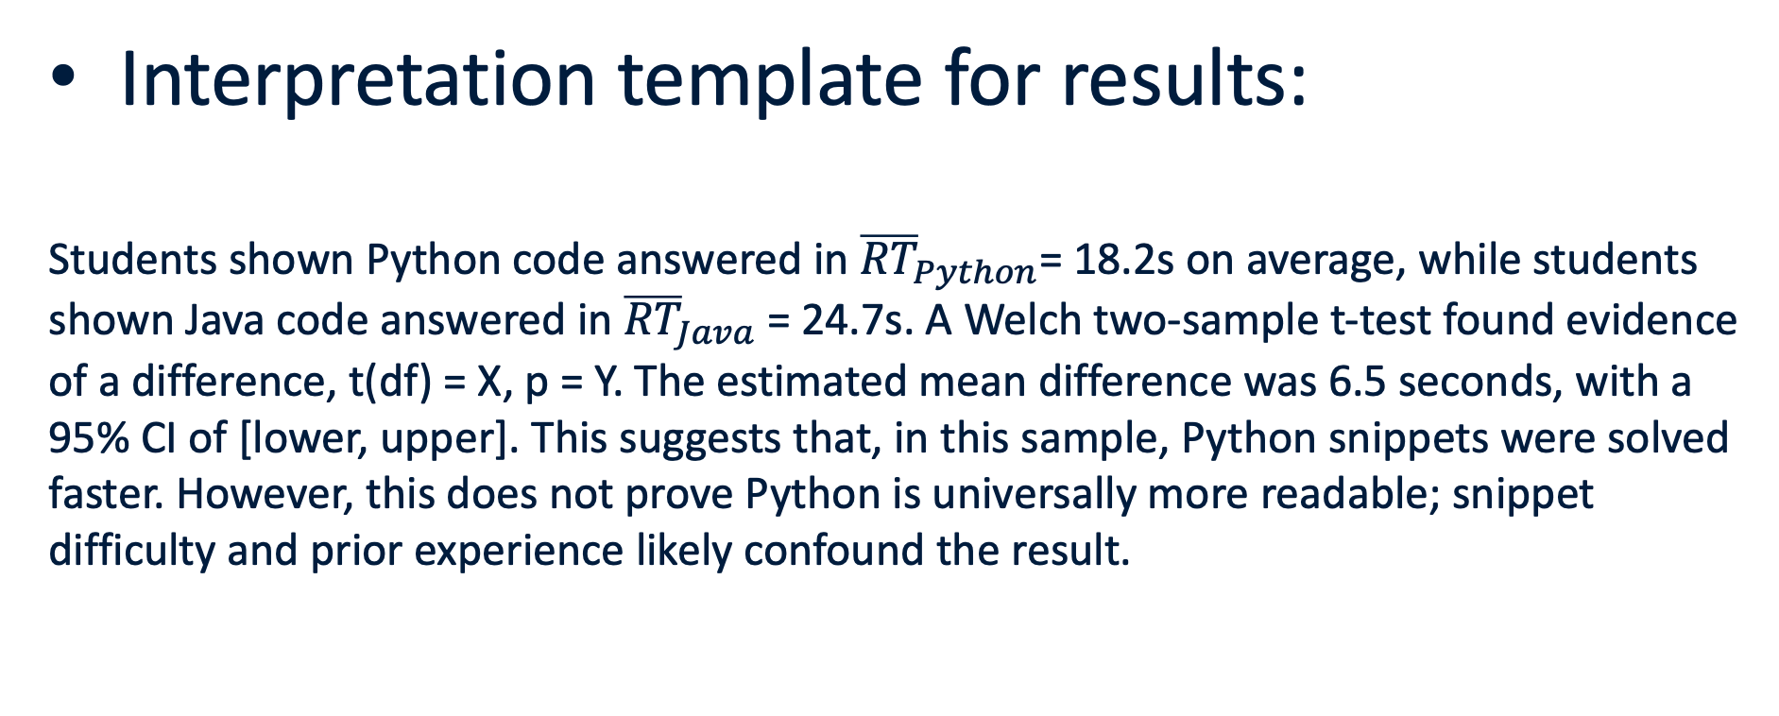
Example 1: Numeric Outcome, two groups
Interpretation template for results:
Students shown Python code answered in ${\overline{RT}}_{Python}$= 18.2s on average, while students shown Java code answered in ${\overline{RT}}_{Java}$ = 24.7s. A Welch two-sample t-test found evidence of a difference, t(df) = X, p = Y. The estimated mean difference was 6.5 seconds, with a 95% CI of [lower, upper]. This suggests that, in this sample, Python snippets were solved faster. However, this does not prove Python is universally more readable; snippet difficulty and prior experience likely confound the result.

Slide 45
Example 2: Numeric (ordinal) outcome, 3+ groups
Research Q: Do restaurant ratings differ by cuisine type?
Outcome: rating from 1–7.
Groups: Italian, Chinese, French, etc.
Test: One-way ANOVA. Or pairwise Mann–Whitney / Wilcoxon / Kruskal–Wallis tests.
ANOVA only says there are differences (by looking at between-group variation against within-group variation), but not between any particular pair – need to do follow up tests for that.

Slide 46
Example 3: Numeric outcome, 3+ groups
Interpretation template for results:
A one-way ANOVA (a test that compares between-group variation to within-group variation) found that mean rating differed across cuisine conditions, F(df_between, df_within) = X, p = Y. Because ANOVA only tells us that at least one group differs, follow-up pairwise comparisons using xxx (use any of Mann–Whitney / Wilcoxon / Kruskal–Wallis) were used to identify which cuisines differed.

Slide 47
Example 3: Categorical outcomes
Research Q: Does dark mode affect whether students detect a planted code error?
Outcome: Detected error (yes/no).
Groups: Dark mode/light mode.
Test: Chi-square test of independence.
Chi-square tests counts, not percentages. Percentages are good for interpretation but the test needs counts, and in fact, it can fail to be a good way to test for association when the counts are too small (note that in limitations!).

Slide 48
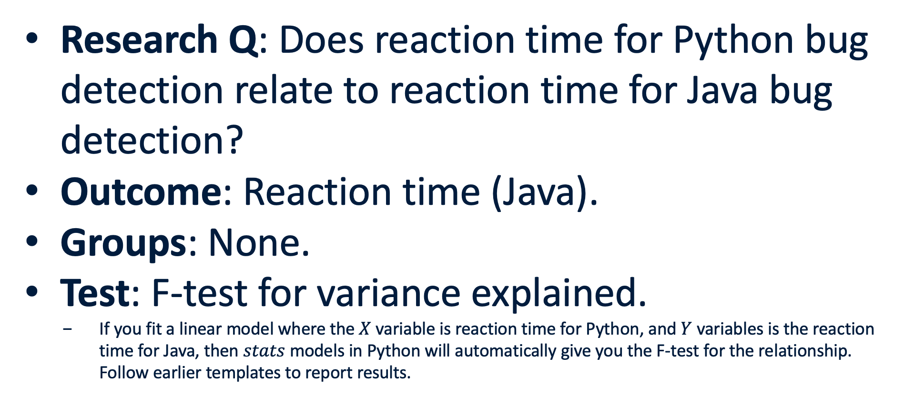
Example 4: Two numeric variables
Research Q: Does reaction time for Python bug detection relate to reaction time for Java bug detection?
Outcome: Reaction time (Java).
Groups: None.
Test: F-test for variance explained.
If you fit a linear model where the $X$ variable is reaction time for Python, and $Y$ variables is the reaction time for Java, then $stats$ models in Python will automatically give you the F-test for the relationship. Follow earlier templates to report results.

Slide 49

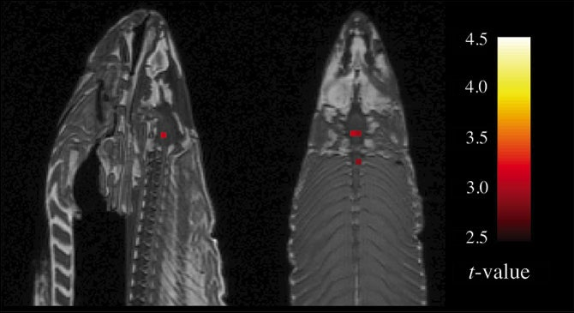
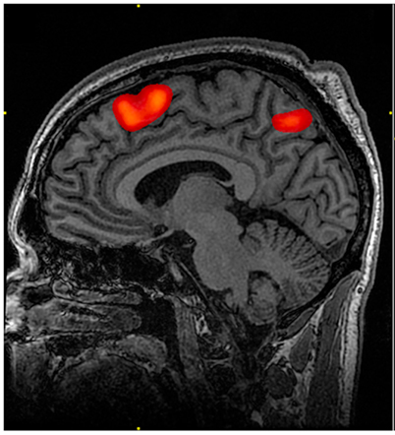
The dead fish’s brain is active!
Notes:
So, as the fish sat in the scanner, they showed it "a series of photographs depicting human individuals in social situations." To maintain the rigor of the protocol (and perhaps because it was hilarious), the salmon, just like a human test subject, "was asked to determine what emotion the individual in the photo must have been experiencing.” P<0.001

Slide 50
P-values: Multiple Testing
Consider what a p-value of 0.05 means. 1 in 20 tests will not reject the null and we get a Type 1 error.
In fact, even when doing just 10 tests, the chance of one significant value is at 40% meaning there is a 40% chance of a false positive (can you prove this to yourself?).
To fix this, if we’re doing 20 tests, we can be conservative and say that we will reduce the p-value to 0.05/20 or 0.0025 – this is called the Bonferroni correction.
So, for example, the tests at each site of the salmon’s brain could be carried out demanding a P-value of 0.05/8,000 = 0.00000625, or 1 in 160,000.

Slide 51
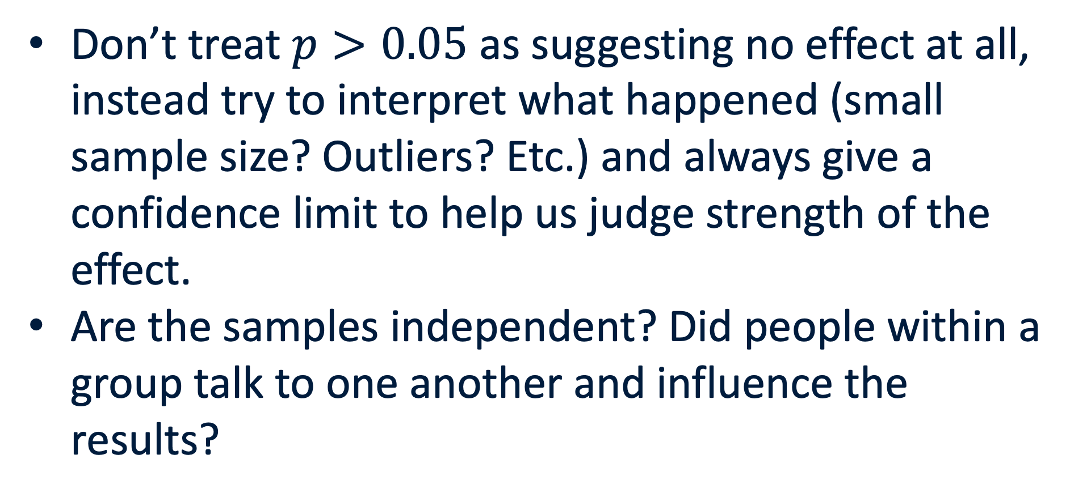
Other potential limitations
Don’t treat $p>0.05$ as suggesting no effect at all, instead try to interpret what happened (small sample size? Outliers? Etc.) and always give a confidence limit to help us judge strength of the effect.
Are the samples independent? Did people within a group talk to one another and influence the results?

Slide 52
Other potential limitations
When using ANOVA or t-tests make sure to check the assumptions.
In the example we discussed, I suggested ANOVA for ordinal data because it was reasonably continuous. But we could alternatively use tests that respect the fact that there are ordinal variables (see earlier table).

Slide 53
Other potential limitations
Don’t p-hack!
Don’t exclude data to get a p-value below 0.05.
Don’t try several tests randomly and report the one with p<0.05.
Ideally, decide hypotheses and outliers before running tests.

Slide 54
Reporting Checklist: Before submitting your report check this.
Did we state null and alternative hypotheses?
Did we identify the outcome and predictor variables?
Did we state the measurement scale?
Did we visualize the data appropriately?
Did we report the sample sizes?
Did we justify the statistical test used?
Did we report the confidence limits as well as p-value?
Did we discuss limitations?
Did our conclusion answer the original research questions?

Slide 55
Could Harold Shipman have been caught earlier?
Obviously, we want to now look at his murders through the lens of statistical significance:
Were his patients dying at a rate that was significantly higher than expected?
We would want to control for events like flu outbreaks and sudden temperature irregularities among other factors that may influence the rates of death.

Slide 56
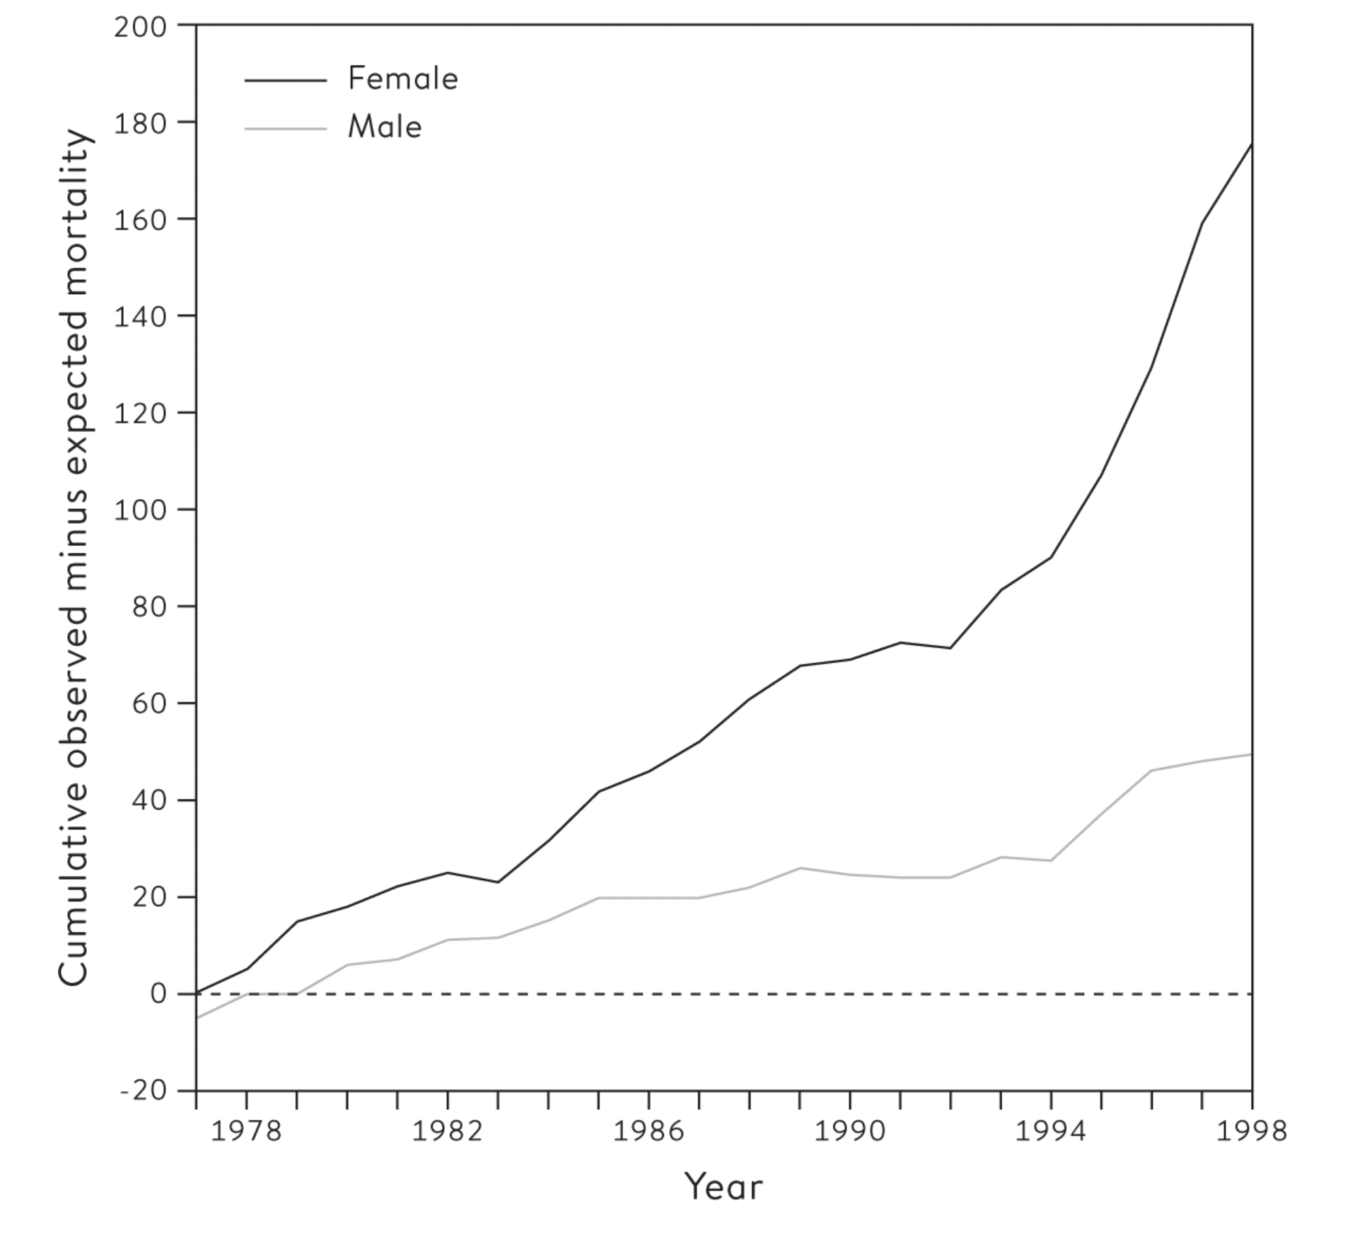
Could Harold Shipman have been caught earlier?
The excess mortality after accounting for the baseline yields 174 women and 49 men, which is very similar to the total number that was eventually discovered from the inquiry.
Notes:
If this had been done using the total deaths for men and women shown in Figure 10.3, then in 1979, after only three years of monitoring, there would have been a one-sided P-value of 0.004 arising from comparing 40 observed deaths while only expecting 25.3.^{fn7} The results could have been declared ‘statistically significant’ and Shipman investigated and detected.

Slide 57
Could Harold Shipman have been caught earlier?
Can assume the Poisson distribution for this since it is a count of people dying.
Then by the time we are at the 3rd year, when a Poisson with mean of 25.3 is expected, we have a P-value of 0.004!
Then we could have stopped Shipman so much earlier! Right?
P = 0.004
Notes:
If this had been done using the total deaths for men and women shown in Figure 10.3, then in 1979, after only three years of monitoring, there would have been a one-sided P-value of 0.004 arising from comparing 40 observed deaths while only expecting 25.3.^{fn7} The results could have been declared ‘statistically significant’ and Shipman investigated and detected.

Slide 58

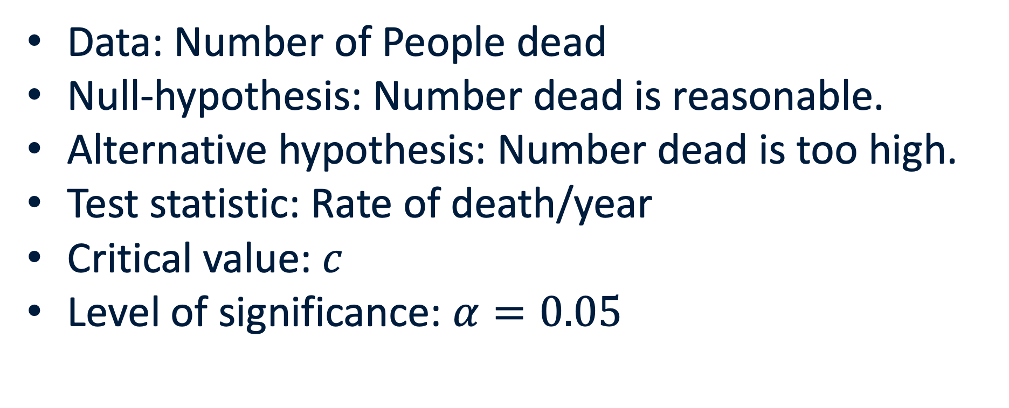

Hypothesis testing
Data: Number of People dead
Null-hypothesis: Number dead is reasonable.
Alternative hypothesis: Number dead is too high.
Test statistic: Rate of death/year
Critical value: $c$
Level of significance: $α=0.05$
$$α$$
$$c$$

Slide 59
Could Harold Shipman have been caught earlier?
Unfortunately, we‘re forgetting that unless we already had our eye on Shipman, we need to run this test for every single doctor – and we don’t want to run investigations on all the false positives since that would be a waste of resources.
What’s an alternative testing strategy?
P = 0.004
Notes:
If this had been done using the total deaths for men and women shown in Figure 10.3, then in 1979, after only three years of monitoring, there would have been a one-sided P-value of 0.004 arising from comparing 40 observed deaths while only expecting 25.3.^{fn7} The results could have been declared ‘statistically significant’ and Shipman investigated and detected.

Slide 60
Could Harold Shipman have been caught earlier?
Say we did do a Bonferroni approach instead, there’s 25000 doctors, so we correct by that number and so, need a p-value of 1 in 500,000 for significance.
Unfortunately, for sequential tests, you’re sure to end up getting a false positive.
P <2e-6
P = 0.004
Notes:
If this had been done using the total deaths for men and women shown in Figure 10.3, then in 1979, after only three years of monitoring, there would have been a one-sided P-value of 0.004 arising from comparing 40 observed deaths while only expecting 25.3.^{fn7} The results could have been declared ‘statistically significant’ and Shipman investigated and detected.

Slide 61
Could Harold Shipman have been caught earlier?
However, when an appropriate sequential testing regimen is performed, we could have caught Shipman in 1984!
This test was then applied to all doctors, and it seemed there was one more doctor with a huge excess of mortalities! Turned out he was helping elderly people stay out of the hospital for their death.
P<2e-6
P = 0.004
Notes:
If this had been done using the total deaths for men and women shown in Figure 10.3, then in 1979, after only three years of monitoring, there would have been a one-sided P-value of 0.004 arising from comparing 40 observed deaths while only expecting 25.3. The results could have been declared ‘statistically significant’ and Shipman investigated and detected.

Slide 62
Statistical Significance
Hypothesis testing is critical part of statistics.
Hypothesis testing depends on defining a null and alternative hypothesis
P-values are a regularly used quantity for decision making.
There are many caveats to significance testing using p-values.
Statistics is mostly a process of remembering which assumptions you may be breaking.

Slide 63
Probability and Statistics
“A statistician’s job is to break results” – unknown statistician.

